Slide 1
INFO7390 Assignment 1 Presentation
Team12
Yalin Li, Zhi Li, Priti Agarwal

Slide 2
Teamwork Arrangements Github URL:https://github.com/pagarwal123/Assignment1_Team12
Part1:
1, 2, 8 Priti Agarwal
3-10 Yalin Li
Part2:
2.1,2.3 Zhi Li
2.1-2.5Priti Agarwal
Part3:
Zhi Li, Yalin Li

Slide 3
Part 1.1, 1.2: Analyzing Banks with asset values greater than $10 Billion
Data: https://www.ffiec.gov/nicpubweb/nicweb/HCSGreaterThan10B.aspx

Slide 4
Consolidate the data into a single csv., data cleansing , stack data
Challenges:
The page given was a .aspx page and hence on every change in dropdown value, the data table changes but the link remained the same.
There were set of banks that did not appear in each of the different quarter. Hence, getting a list of all banks in all quarters was a challenge.
Approach:
Idea to go for automation
Used “RSelenium” to automate the site
With the help of RSelenium, each dropdown element was found using xpath
Workflow:
Since its an aspx page, we need to perform an automation on the page wherein the dropdown is selected one by one and the page source is retrieved and the data frame is created along with a csv. At the end all the data frames are merged into one csv

Slide 5
What was the process followed?
Steps followed:
Setting up Selenium server and connecting:
Install package RSelenium in R
Start selenium from console: navigate to the location jar file is downloaded . Run the command: java -jar selenium-server-standalone-2.53.1.jar
RemoteWebDriver instances should connect to: http://127.0.0.1:4444/wd/hub
RSelenium has a main reference class named remoteDriver. To connect to a server you need to instantiate a new remoteDriver with appropriate options.
To connect to the server use the open method: remDr$open()

Slide 6
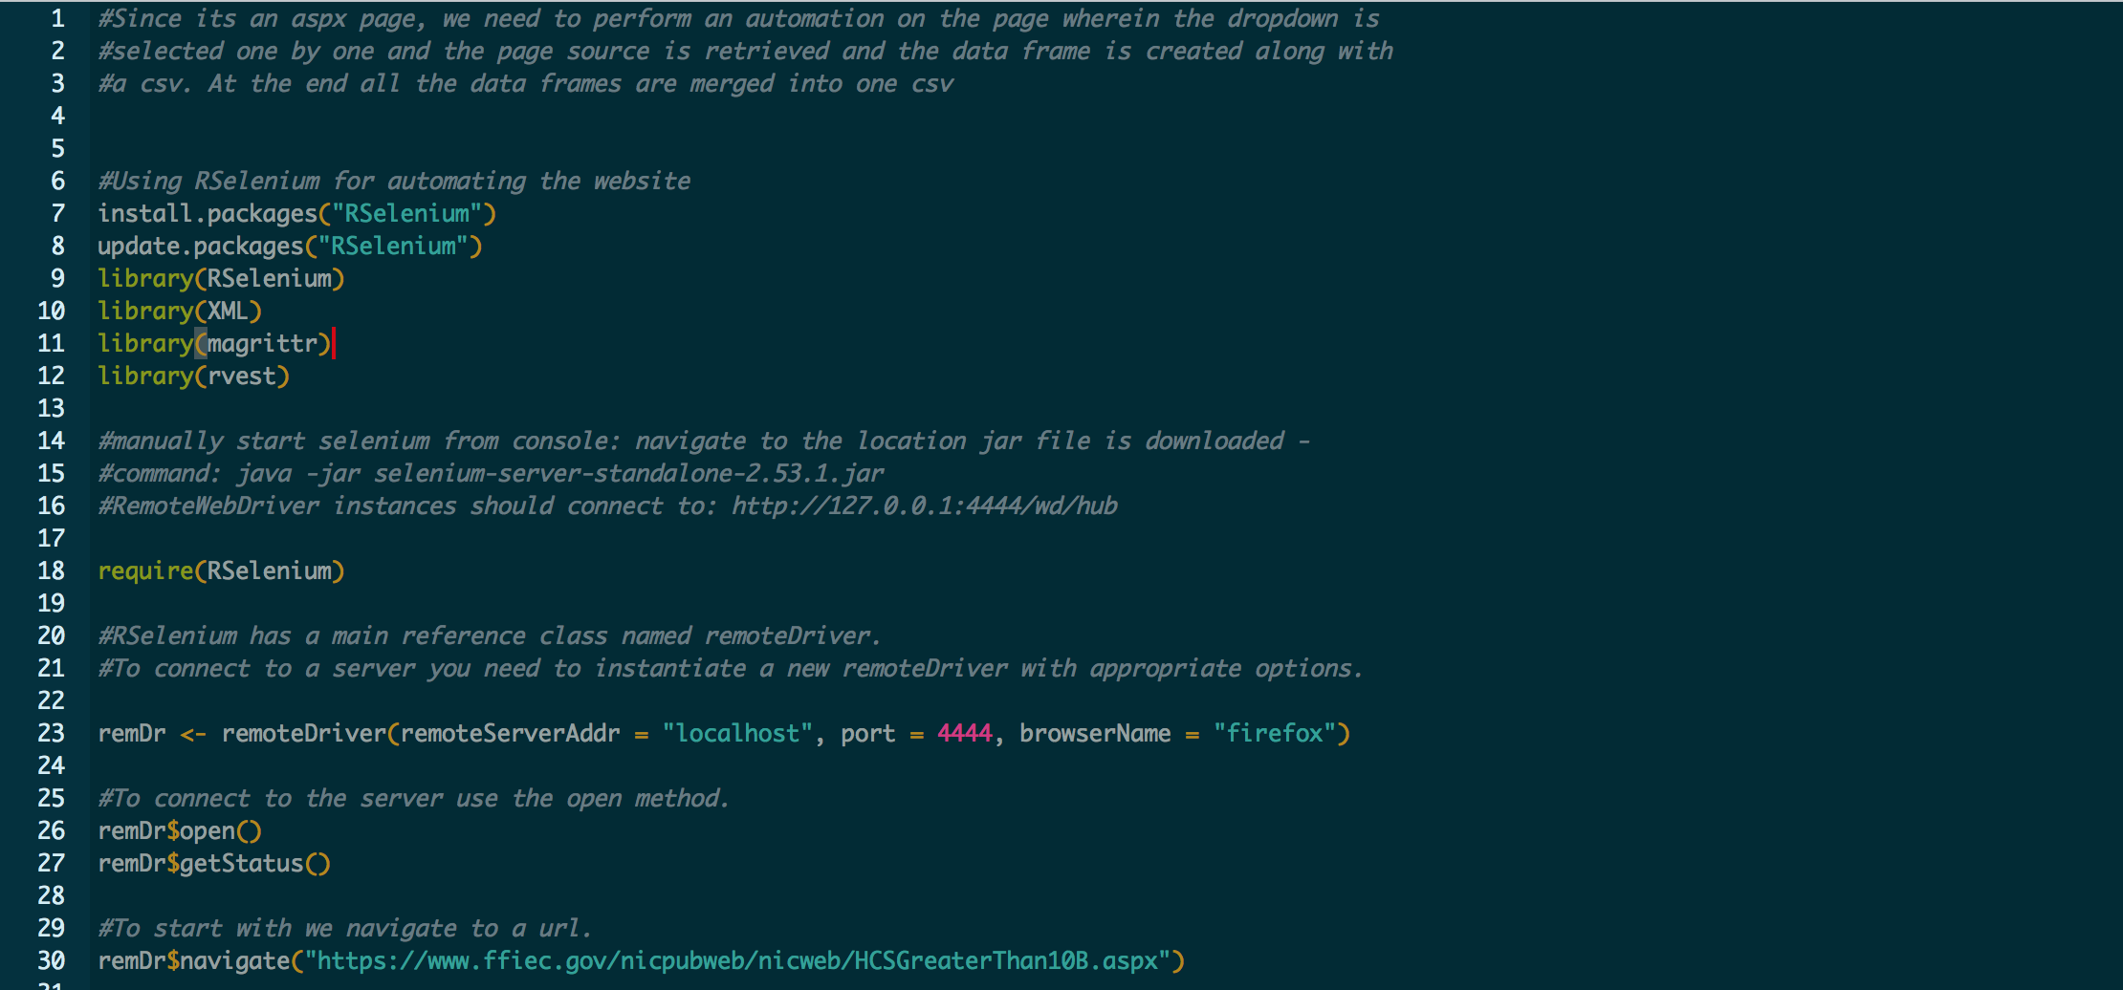
R script

Slide 7
What was the process followed? – Convert into single csv for all quarters
After the Selenium server is connected, following steps are executed:
Navigate to url: https://www.ffiec.gov/nicpubweb/nicweb/HCSGreaterThan10B.aspx
Retrieve the values of a dropdown by finding the element “DateDropDown” dropdown box by its id
Seperate the values from \n as they appear in this format: 0160630\n20160331\n...
Create an empty list to enter each dataframe
Run a loop, where each dropdown is selected, and the page is received, data frame is created for each and put in the list named list_sb
Each datedropdown element is found using xpath and clicked.
HTML element is read using the getPageSource() method
Pieces of 'table' element is retrieved usinh html_nodes
Data cleaning: First 8 lines are removed which are not needed in the csv file.
Column names are renamed using the first line of the row.
Rownames are re-named with a correct order as 1:number_of_rows
There is an unwanted row created at the bottom: so that is deleted as well
All the extra columns with NA values is deducted.

Slide 8
What was the process followed? – Convert into single csv for all quarters
Since later all the data frames will be merged, so the Rank will change. Hence, Rank column is removed.
An extra date column is included as later we will need to merge the data frames and get the stacked data
Column name for total Asset is renamed to remove the Date value
Define the format of date for the Date column and place dates.
Rename date column with index 1, 2, 3 .... so that each total asset and date can be distinguished for each date dropdown data
Insert the data frame to list_sb
Copy data frame to csv file with the name as Data_date.csv
Collect all the data frames and merge into a single data frame
Write data frame to csv

Slide 9
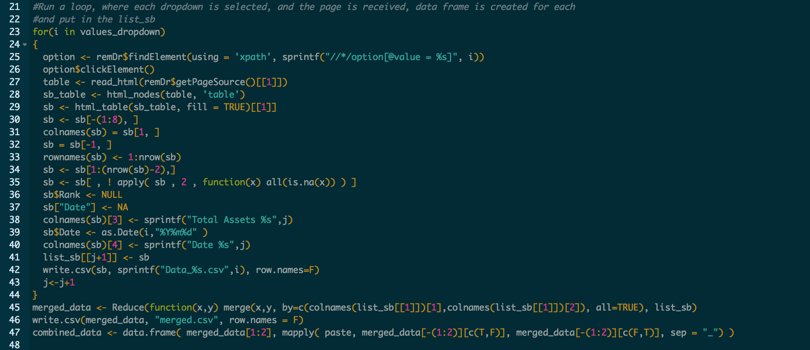
R script

Slide 10
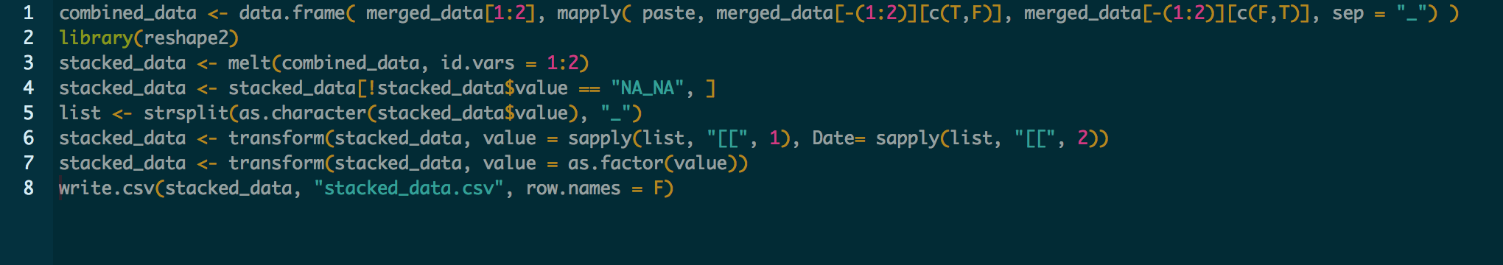
What was the process followed? – Convert unstacked data to stacked data
For each bank,total asset and date is combined with _ seperator
Data is stacked for each bank where a variable column holds the column name of Total Asset and value column holds the combined value of total assets and date
Rows with NA_NA combined value is moitted
The last column is split with underscore and stored in a variable
The last two columns are added to the stacked data i.e. the values of total assets and date in the stacked data dataframe
Column with total asset values are converted into factors so that they are not character
Write stacked_data frame to csv

Slide 11
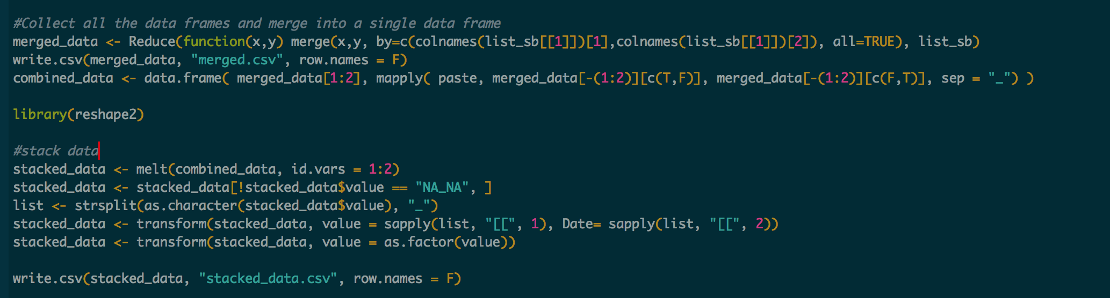
R script

Slide 12
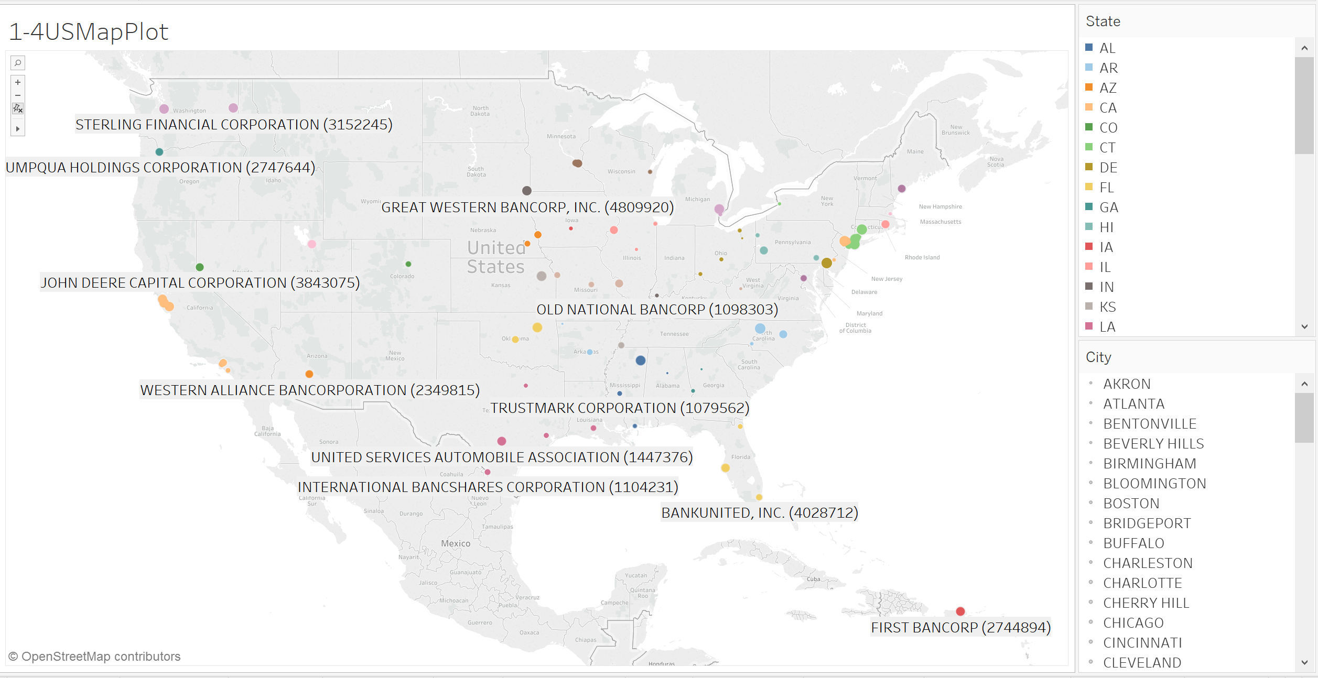
Part1-4
Plot all banks on the US Map using location information

Slide 13
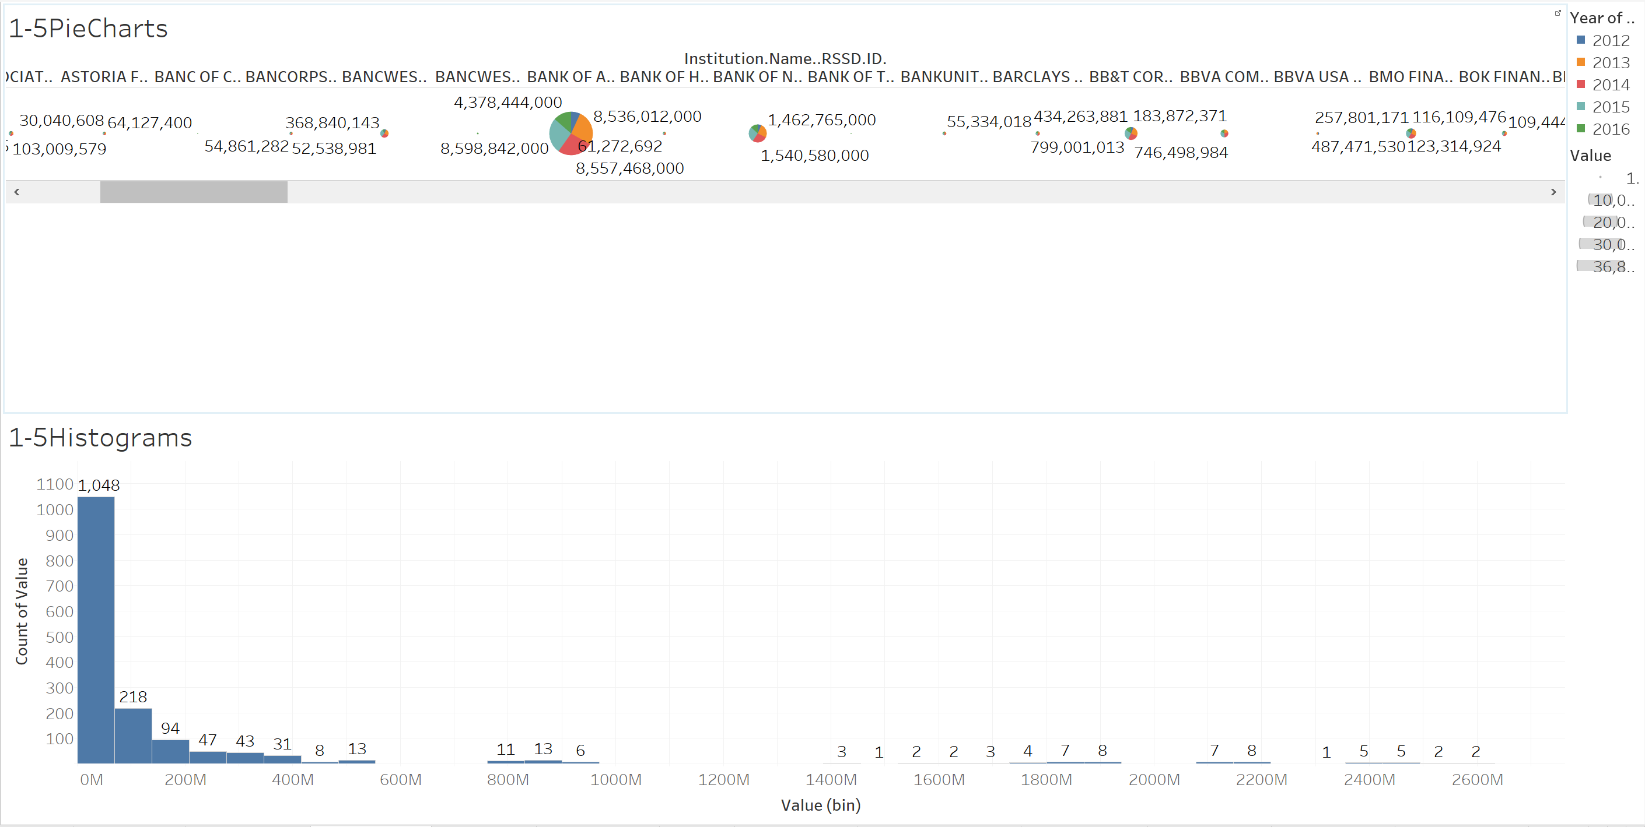
Part1 -Dashboard1
Using pie charts describe each year value in every bank
Using histogram to describe bank distribution according to value of each bank

Slide 14
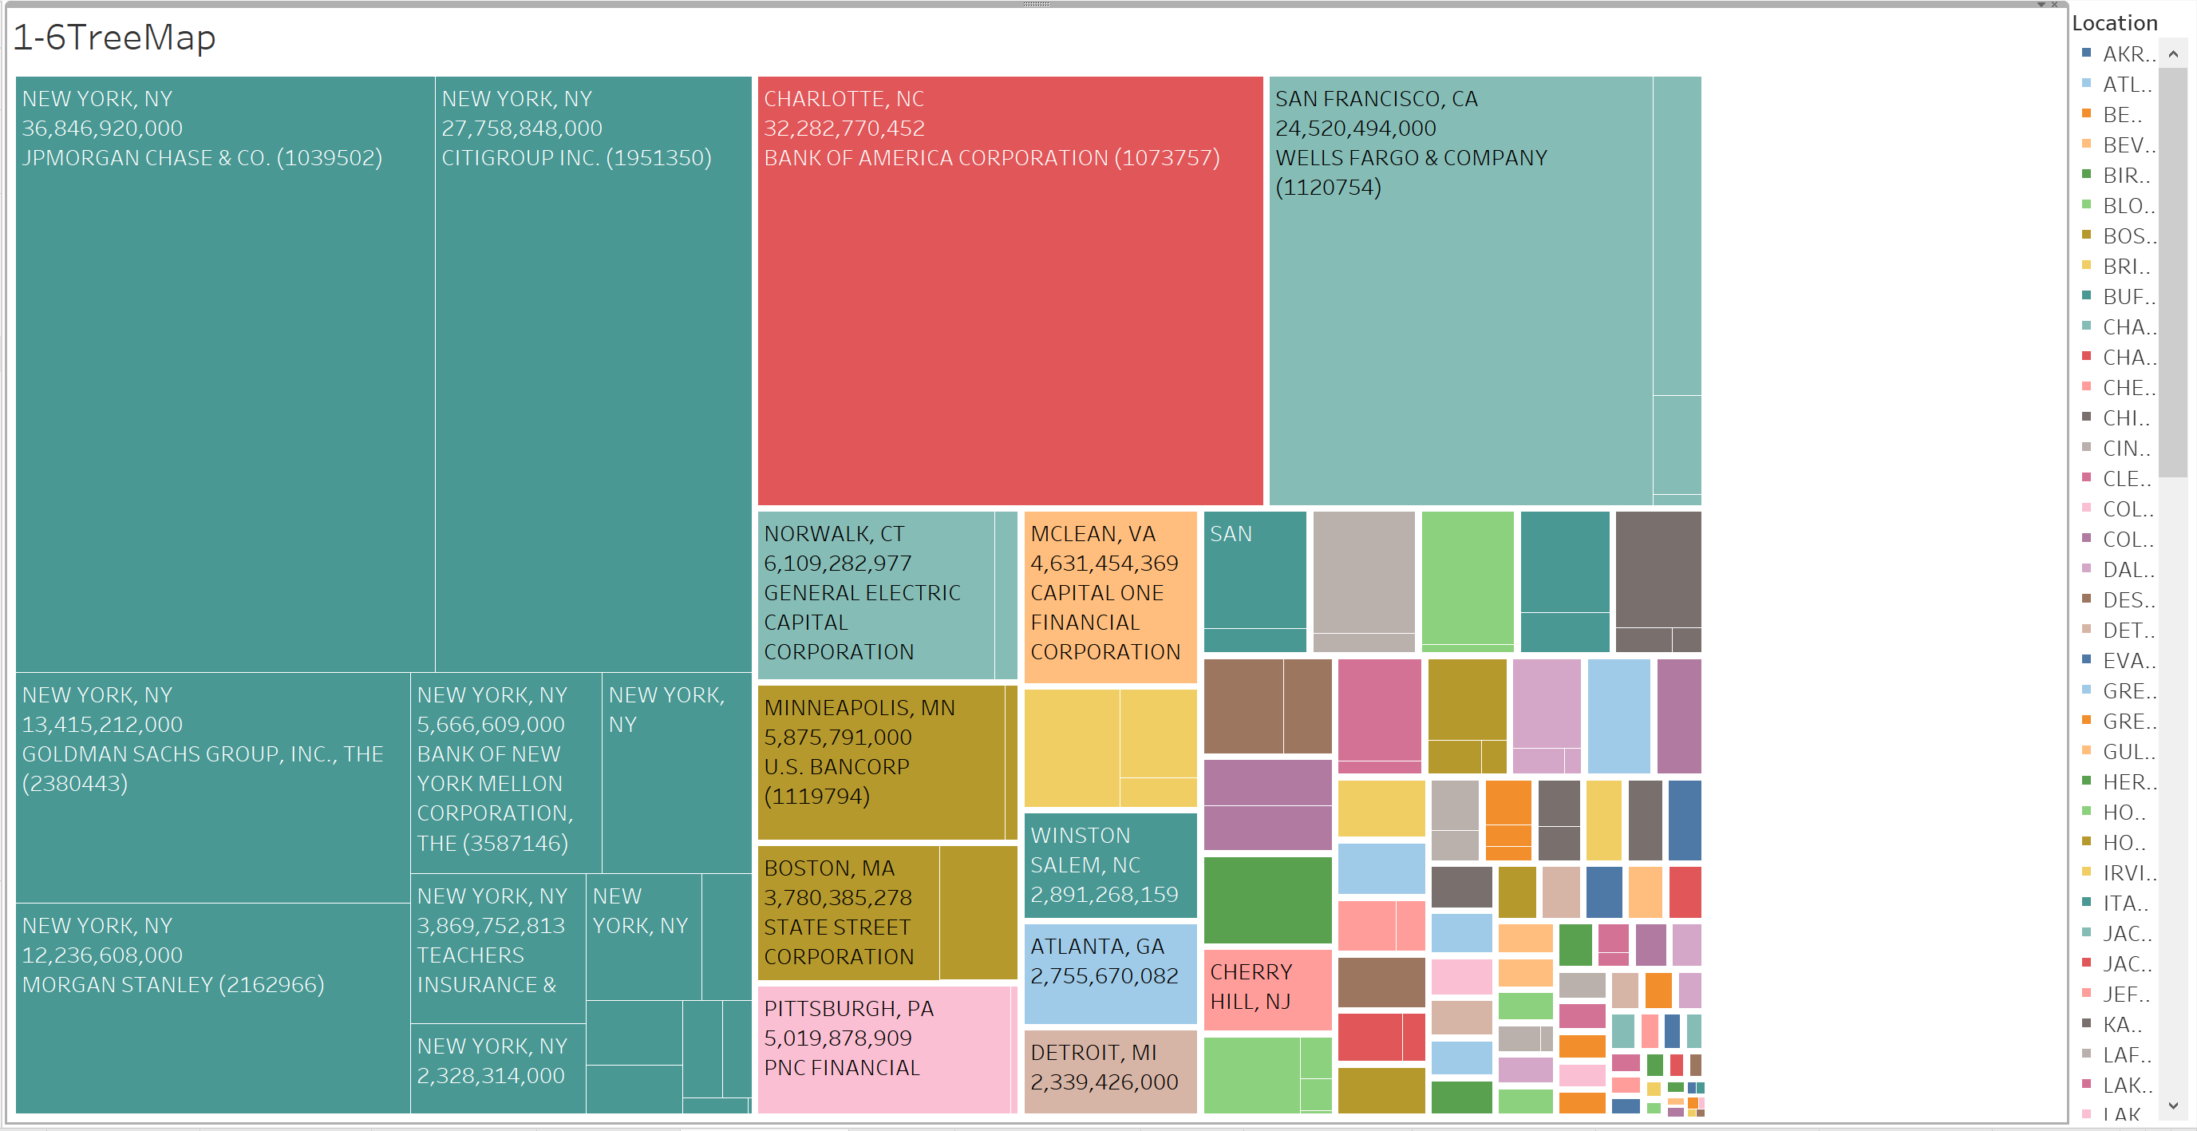
Part1 -Dashboard2
Do tree map by state, show the scale of value by state directly.

Slide 15
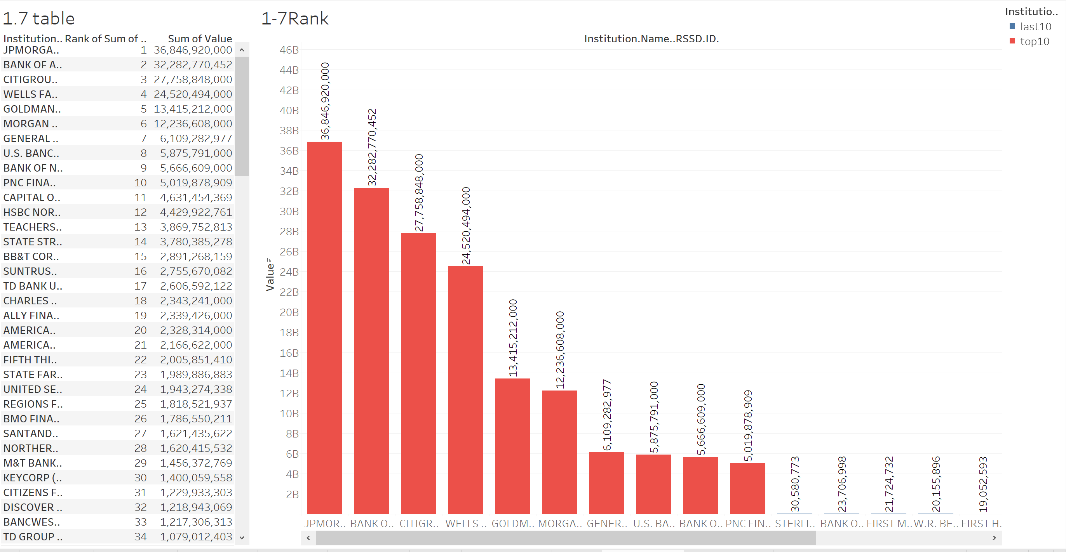
Part1 -Dashboard3
Ranking the whole banks by value, filter top10 banks shown in red and last 10 banks shown in blue.

Slide 16
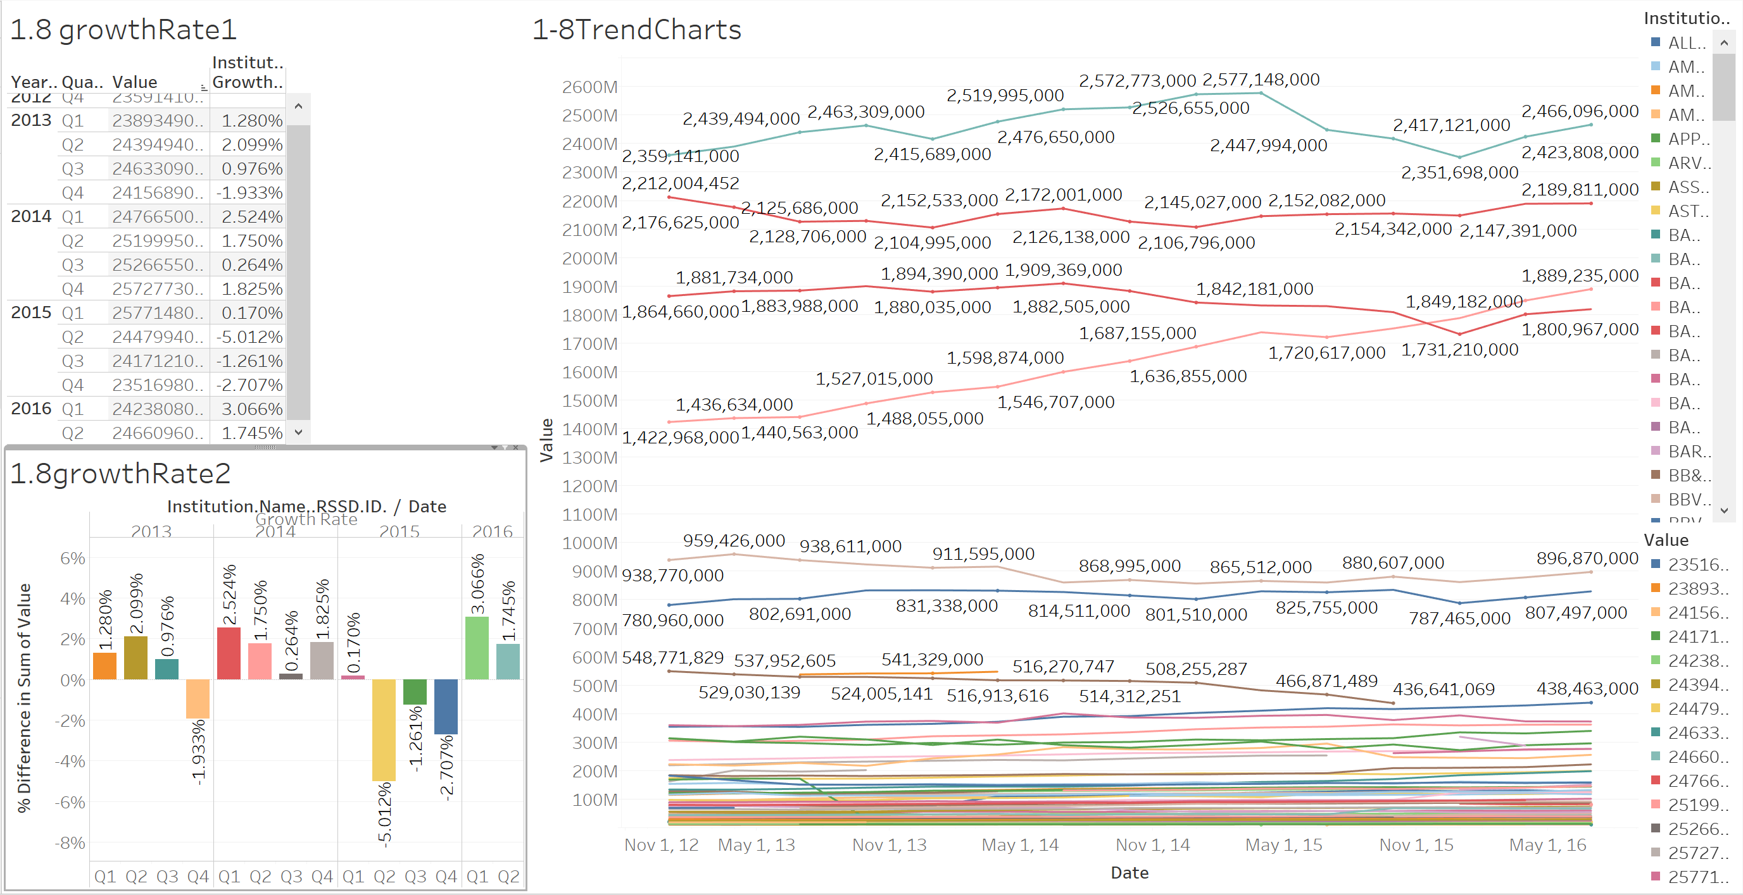
Part1 -Dashboard4
The time series trend of each bank,
Actual value and growth rate are also shown.

Slide 17
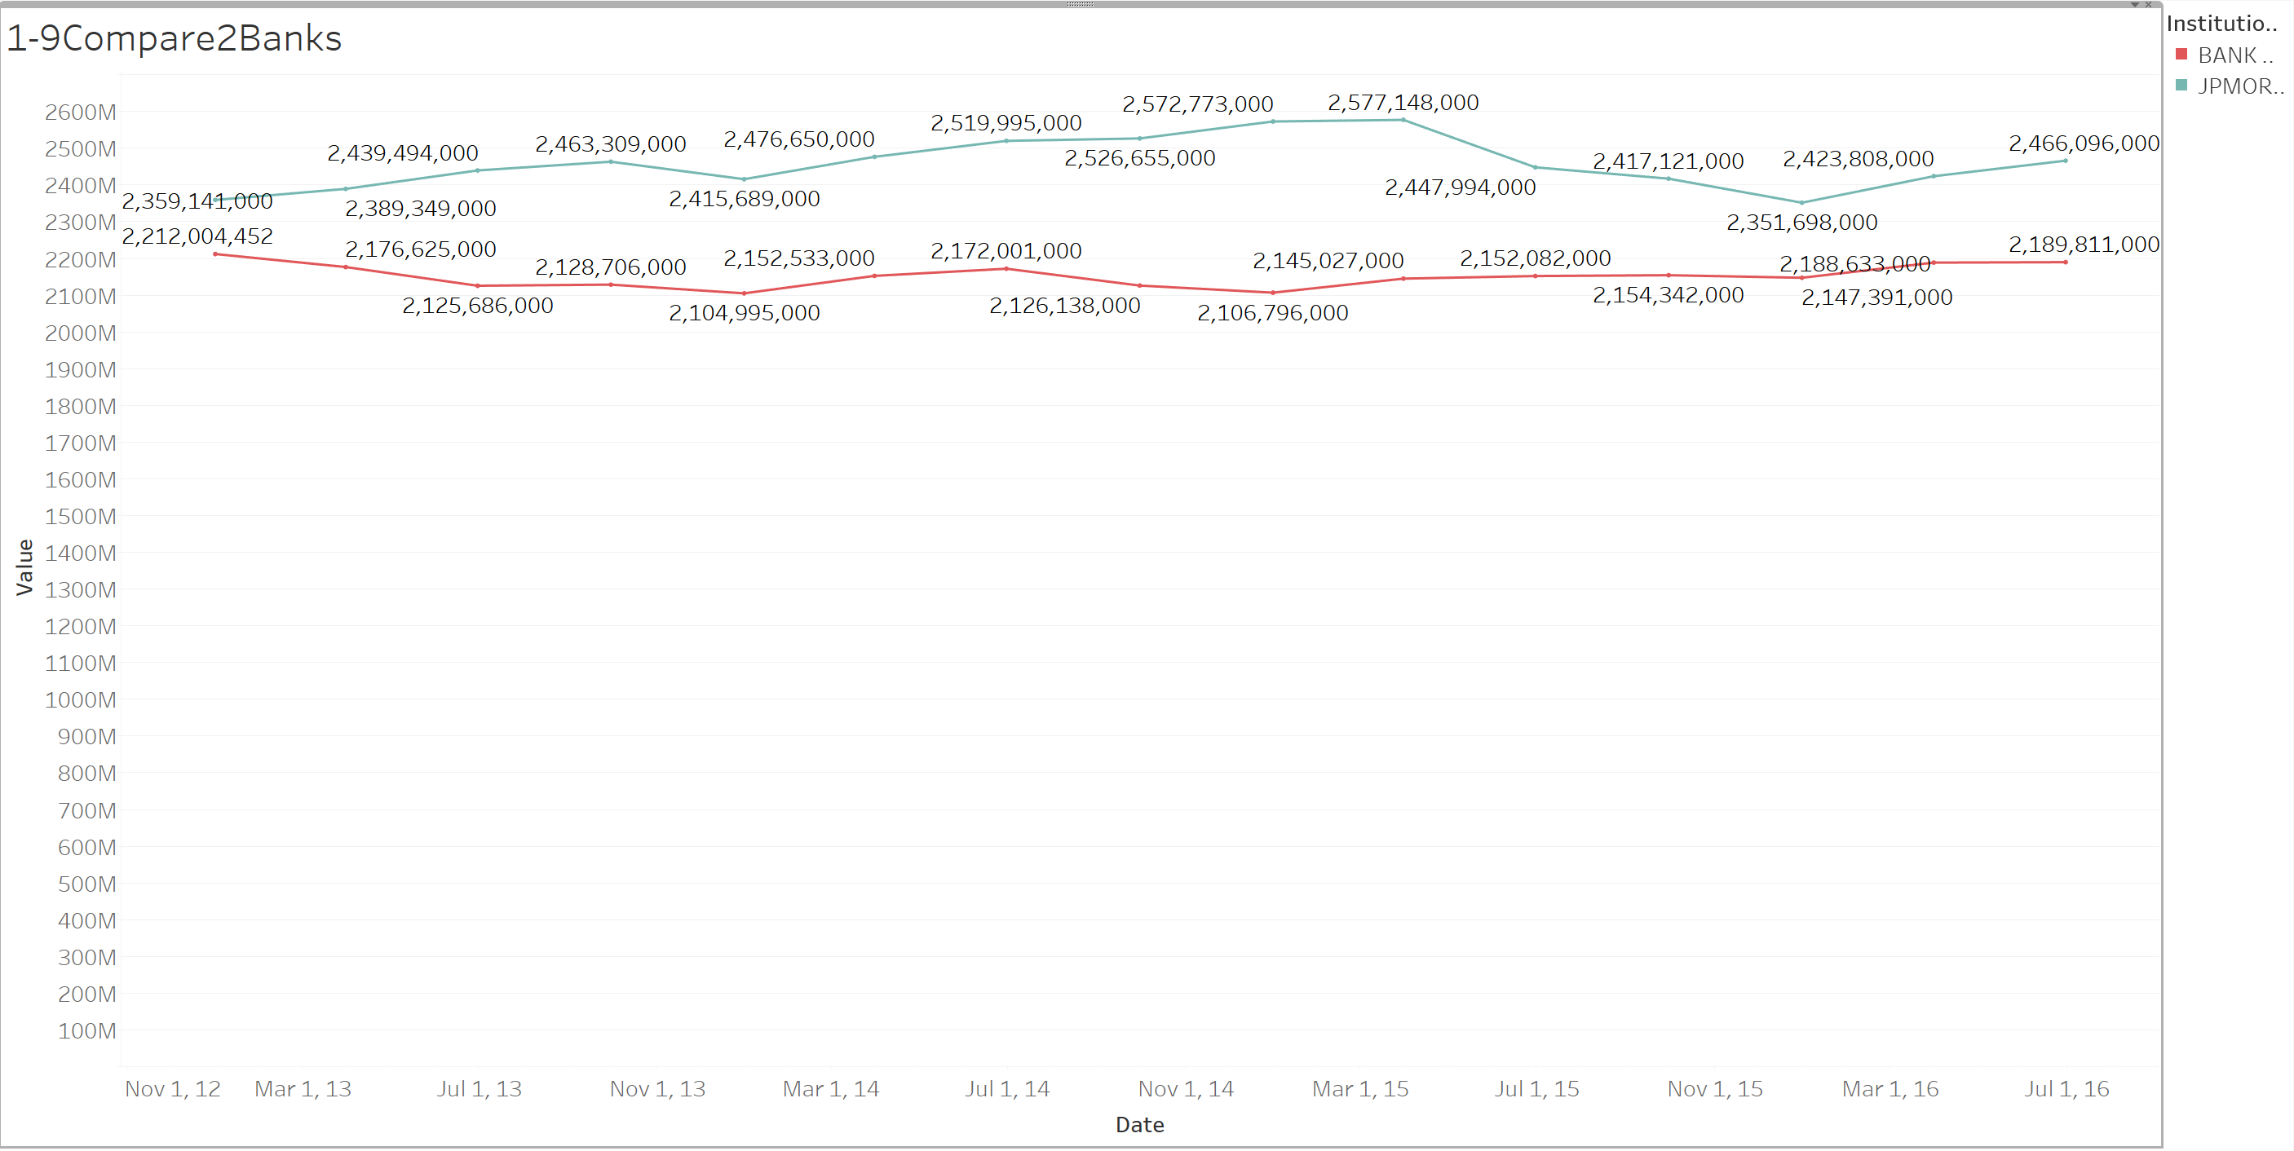
Part1 -Dashboard5
Choosing two banks randomly from the plot in Dashboard4 to compare.

Slide 18
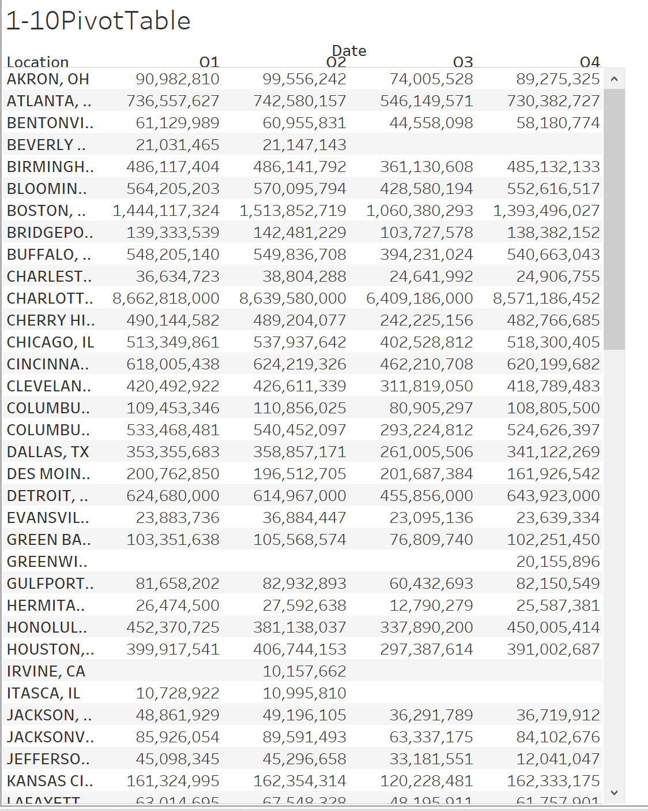
Part1 -Dashboard6
Show a pivot table of the total asset values by state and quarter.
We can see some values are null.

Slide 19
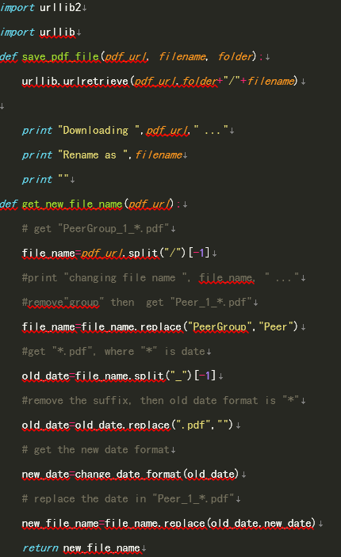
Part2–Download PDF:Python
Using Python import “urlib”and”urlib2”folder
Create a folder which save download files
Renamed file name and date

Slide 20
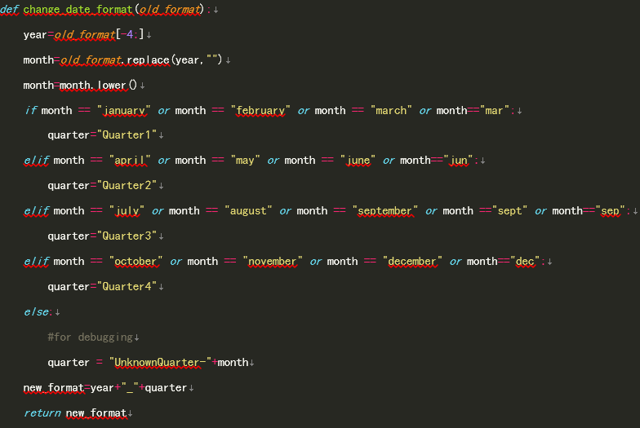
Part2–Download PDF:Python
Renamed filename in Quarter part.
Every old file name include “January”, “February”, “march” and “mar” will renamed in “Quarter1”
Every old file name include “april”, “may”, “june” and “jun” will renamed in “Quarter2”
Every old file name include “july”, “august”, “september” and “sept” will renamed in “Quarter3”
Every old file name include “october”, “november”, “december” and “dec” will renamed in “Quarter4”

Slide 21
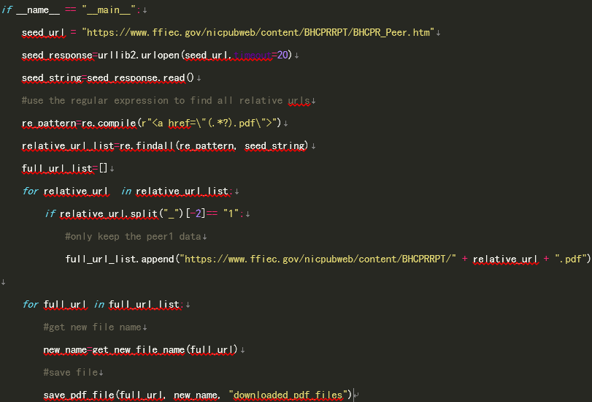
Part2–Download PDF:Python
Using regular expression to find all relative urls
Write a loop to only keep peer1 data
Get new file names and save in the folder

Slide 22
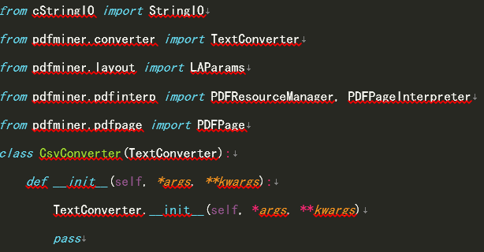
Part2.challenge –Convert CSV :Python
Import pdfminer which can transfer pdf to txt

Slide 23
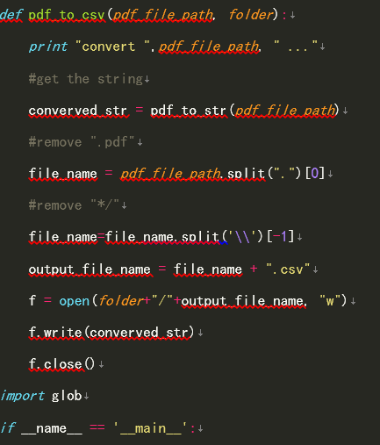
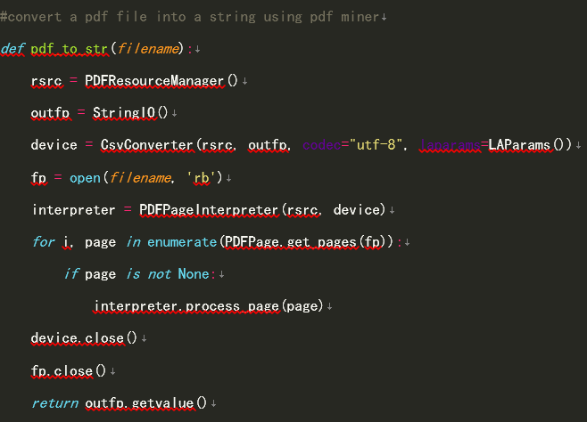
Part2.challenge –Convern CSV:Python

Slide 24
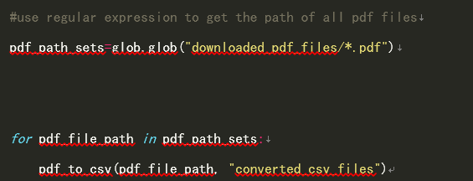
Part2.challenge–Convert CSV:Python
Using regular expression to get the path of all pdf files
Using for loop to converted csv files

Slide 25
Part 2: pdf Data scraping
Data: https://www.ffiec.gov/nicpubweb/content/BHCPRRPT/BHCPR_Peer.htm

Slide 26
Scrape the page, get pdfs for all Peer 1 banks and extract into xlsx/csv, data cleaning
Challenges:
The pdfs could not be scraped into csv/xlsx directly.
After scraping the pdfs, the lines were not ordered and the format changed.
There were three different structures in one pdf
Data was not clean
Approach:
Idea to write some part of code in R and some in python
First, extract pdf links of only Peer1 data using BeautifulSoup in python
Then, download the pdfs from the link in R
Then, Read pdf and convert to text files using PyPDF2 in python
Then, the txt files to xlsx format in R for each part of text file.
All the script is written in python. We basically integrated R and python. So, R scripts were called from python.
We adopted to convert pdf to xlsx
Close observation of data was taken

Slide 27
Scrape the page, get pdfs for all Peer 1 banks and extract into xlsx/csv, data cleaning
Process Workflow:
All the pdf lines is captured in a txt file using python
All the pdf is downloaded into a single directory using R and named: PeerGroup_1_quarter_Year.pdf
All the pdfs are iterated one by one in a loop and converted into their respective txt file and named PeerGroup_1_quarter_Year.txt in python
Each txt is iterated using a loop and for each txt we have 3 parts converted into 3 excel sheets named: PeerGroup_1_quarter_Year_Part1/2/3.xlsx in R
So, basically we just need to run one python script which in turn runs R scripts integrated to it and creates 3 directories named: PeerGroup_1_xlsx, PeerGroup_1_txt, PeerGroup_1_pdf.
Each directories have respective files as mentioned created one by one in an iteration

Slide 28
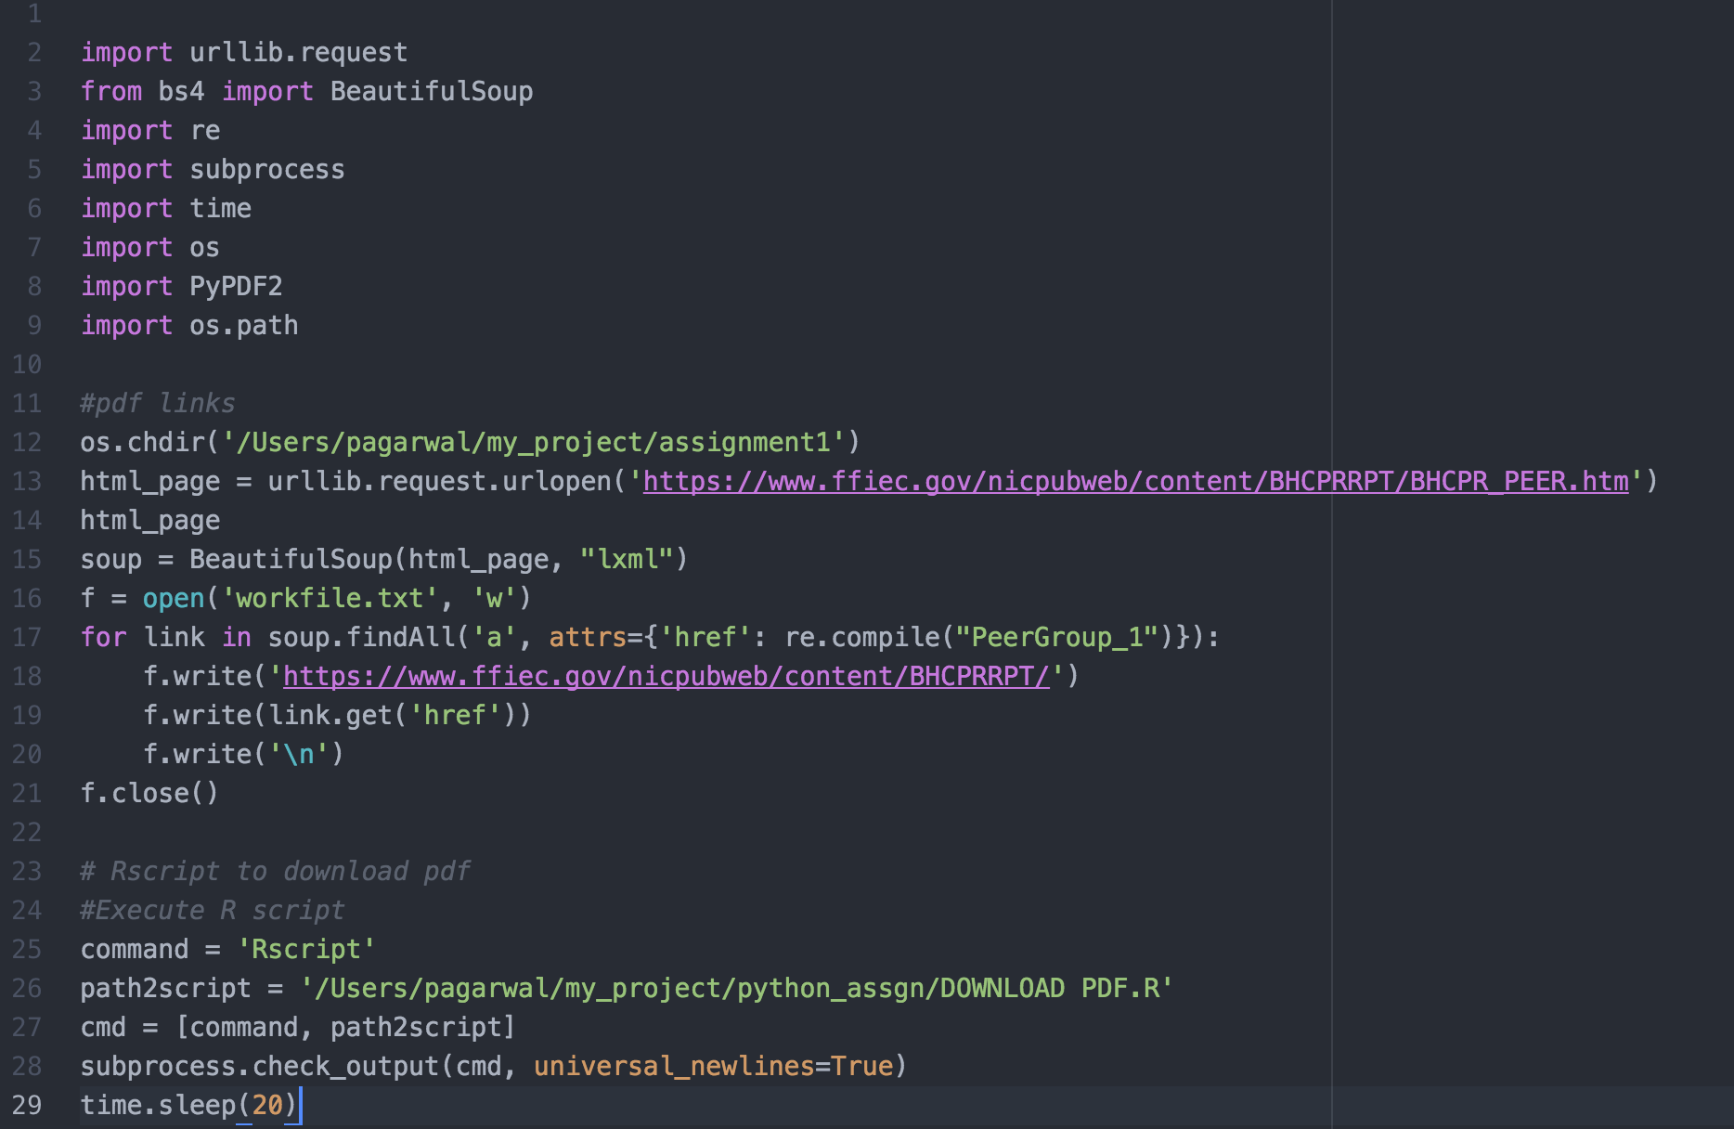
Python script

Slide 29
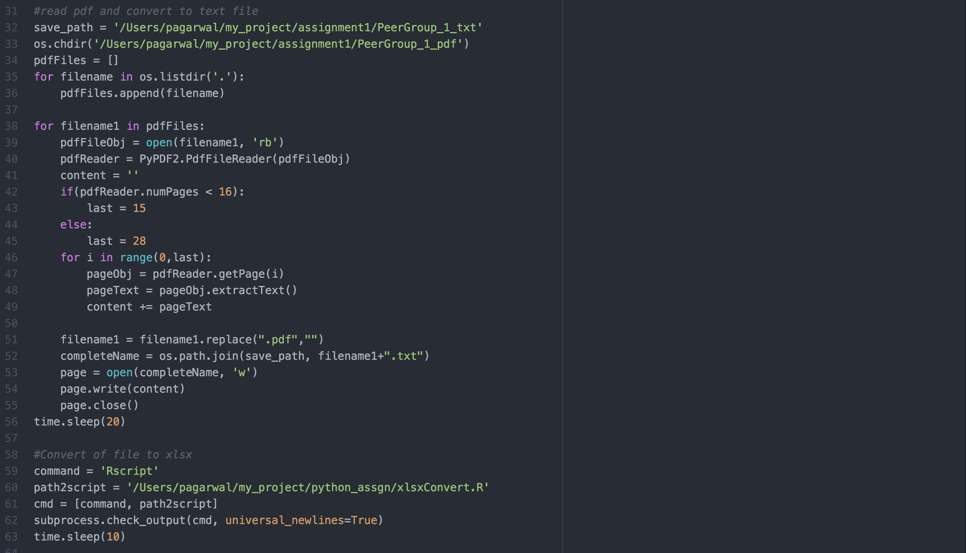
Python script

Slide 30
What was the process followed? – Convert into pdf to xlsx, Data cleaning
After the pdf is converted to txt in python, following steps are executed to convert to xlsx and perform data cleaning:
All the files with .txt extension are stored in the files variable as names.
Data cleaning is performed and converted to xlsx:
Since the txt file contains all the three structures of data, we get the first part of txt file by finding a starting pattern of the second part and storing its index.
Now, x1 is created from first line to the (start line of part1 -1)
“PAGE", "PEER GROUP 1" is a word that appears on each page and is not needed, hence its deleted
If line starts with space,digit, space then that line is removed. This is basically to remove lines containing only single digits it is actually a part of "PAGE" word which goes onto the next line
If line starts with space,digit,word,space then that line is removed.This is basically to remove lines containing only single digits it is actually a part of "PAGE" word which goes onto the next line
If line starts with spaces,digit,digit,"/" then that line is not disturbed.

Slide 31
What was the process followed? – Convert into pdf to xlsx, Data cleaning
If line does not starts with spaces,digit,digit,"/" then folowing operations are checked:
If the line starts with space,"-","-" then the line is removed. There are two checks for two "-” characters as there are line that start with negative value with "-" sign and we dont want to disturb them. We need to remove lines with "-----+”
If the line starts with spaces, then just remove the space for each of the line.
Spaces at the end of the lines is removed.
There are numbers eg: 2,300. The comma has to be removed as later we will be inserting comma as seperator between each column and converting to data frame
Fill lines with multiple spaces with comma as it can serve as a seperator to convert into a data.frame
Convert into dataframe with comma seperator
Rename the name of each column as the third row's values
Now there are extra columns that are created where in the values of rows are shifte by 2. Hence shift the value of rows by two for only those rows
When the shifting was done, there were date values that got appended to the first column for 13 rows. So, removing those values
Convert class to numeric.
Decide the excel name and write to xlsx

Slide 32
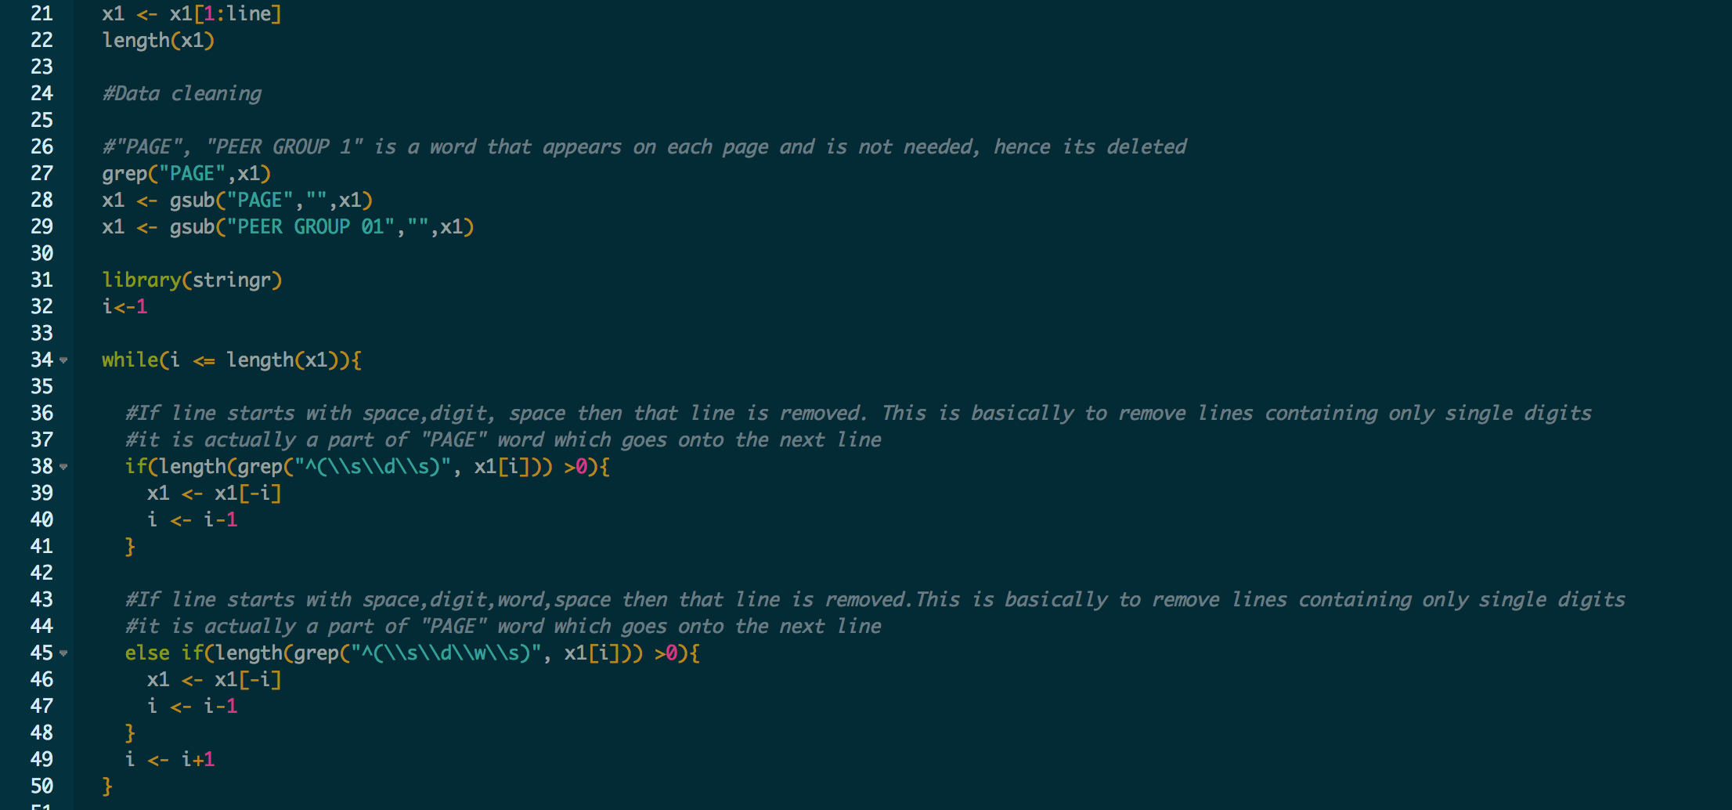
R script

Slide 33
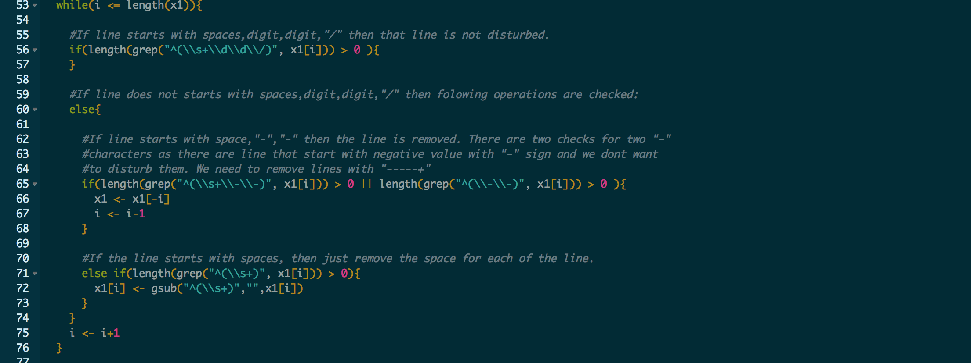
R script

Slide 34
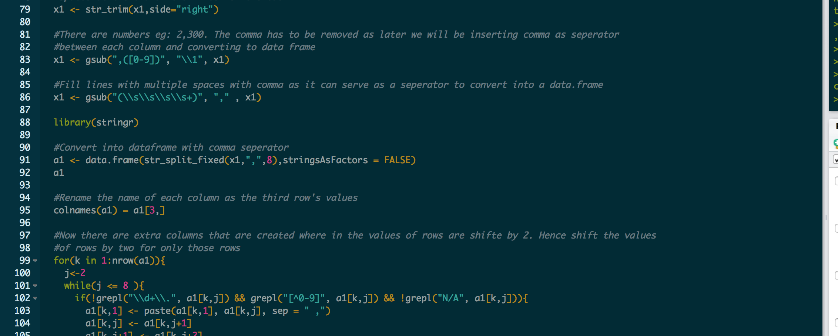
R script

Slide 35
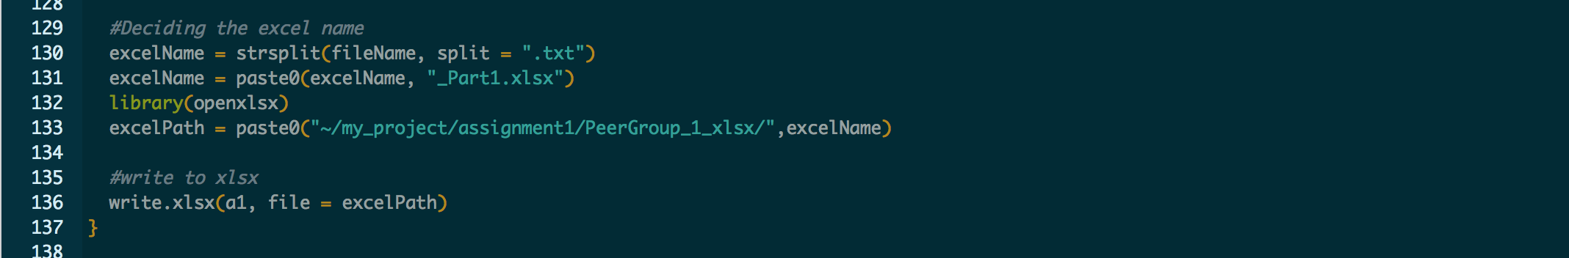
R script

Slide 36
Part3.1 - Analysis of Banking Organization Systemic Risk Reports for the years 2012, 2013 and 2014
Challenges:
Clean all three year data together, because of there are not all banks have values in every year.
Workflow:
After all data cleaned, set each value in sheets and make dashboard.
Others:
We only use the data from Indicators because Line Items include more data we don’t need to use.

Slide 37
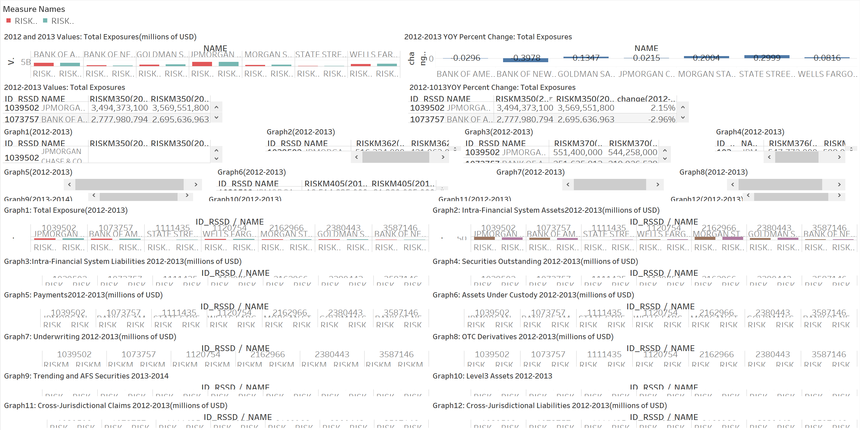
Part3.1 -In Graph Sheets(Dashboard Graph 1.a)
2012-2013 data include
2013-2014 data include
Put two each years data into 1.a and 1.b

Slide 38
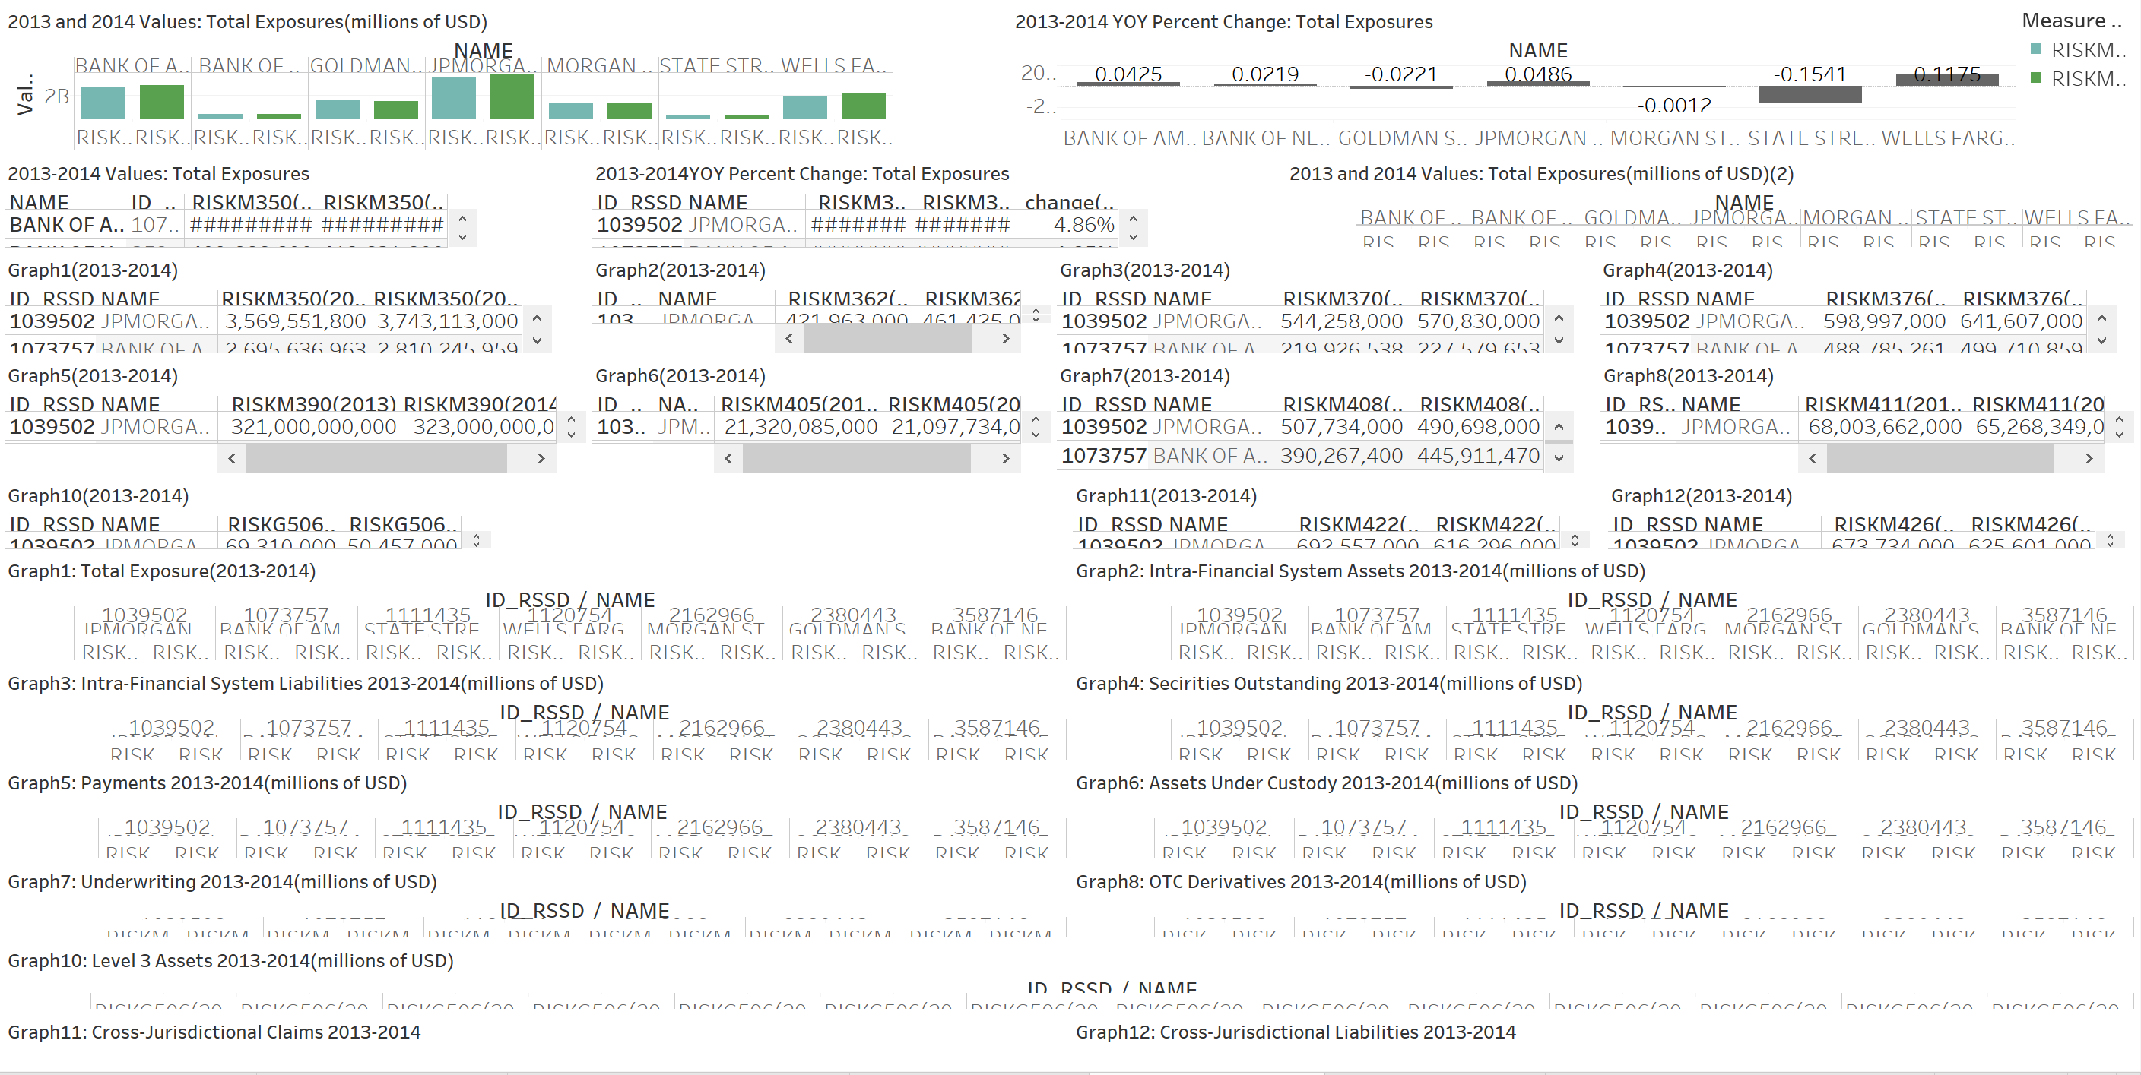
Part3.1 -In Time Series Sheets(Dashboard Graph 1.b)
2012-2013 data include
2013-2014 data include
Put two each years data into 1.a and 1.b

Slide 39
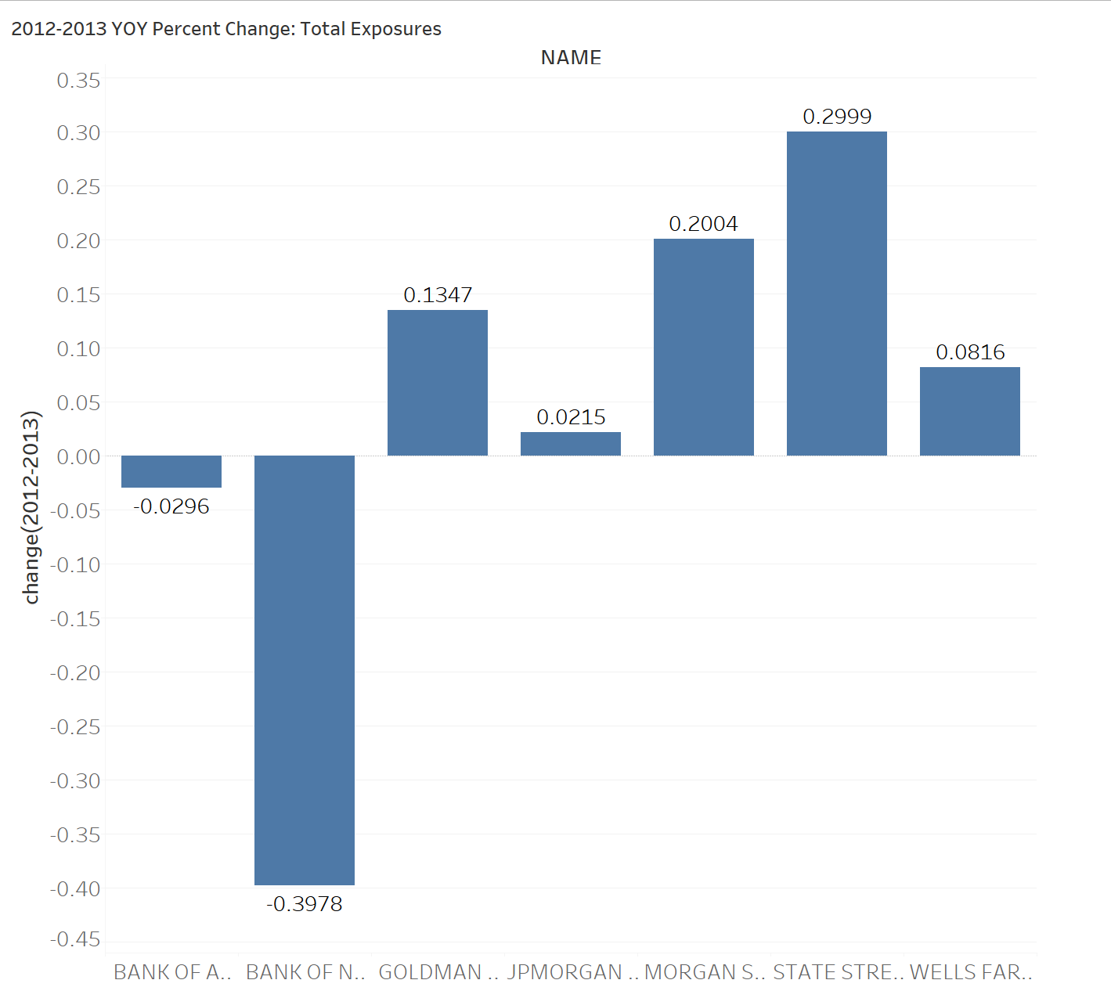

Slide 40
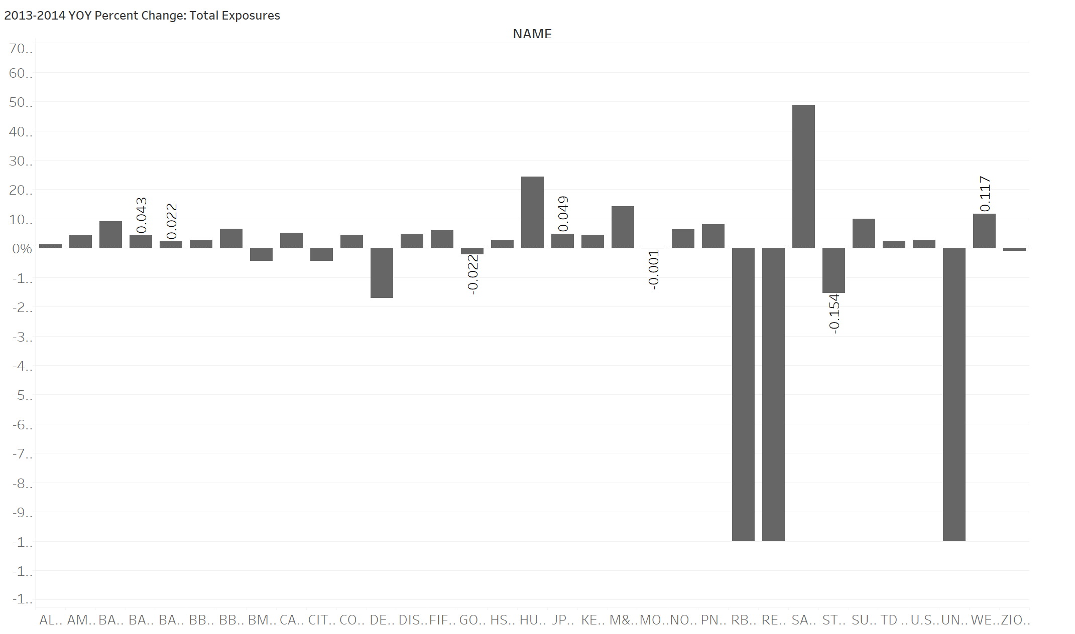

Slide 41
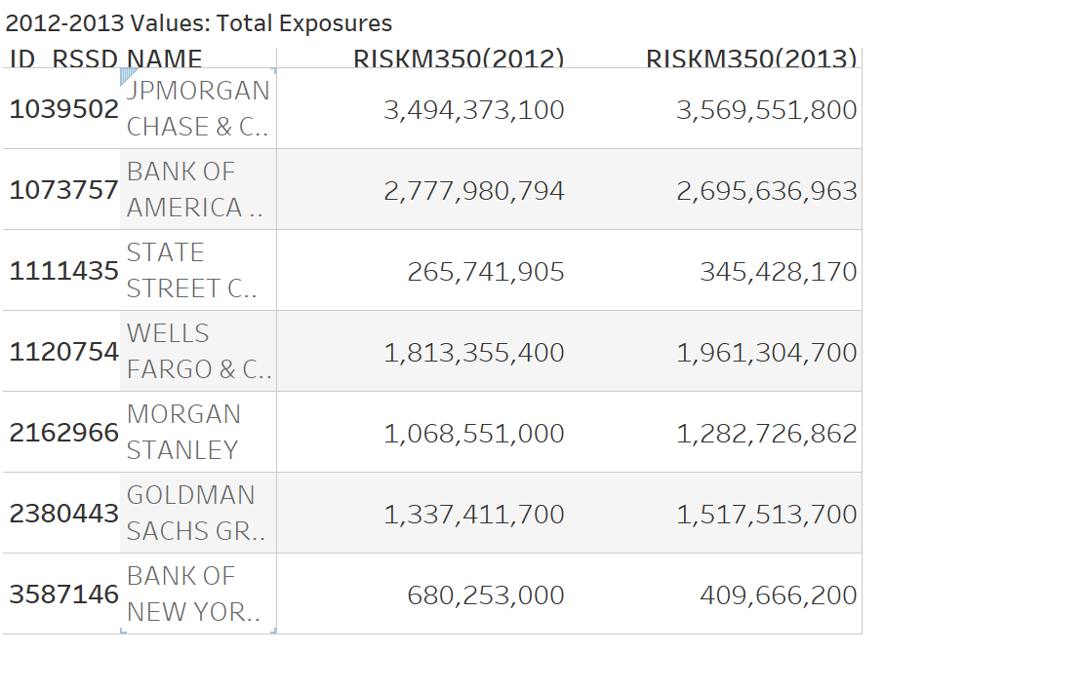

Slide 42
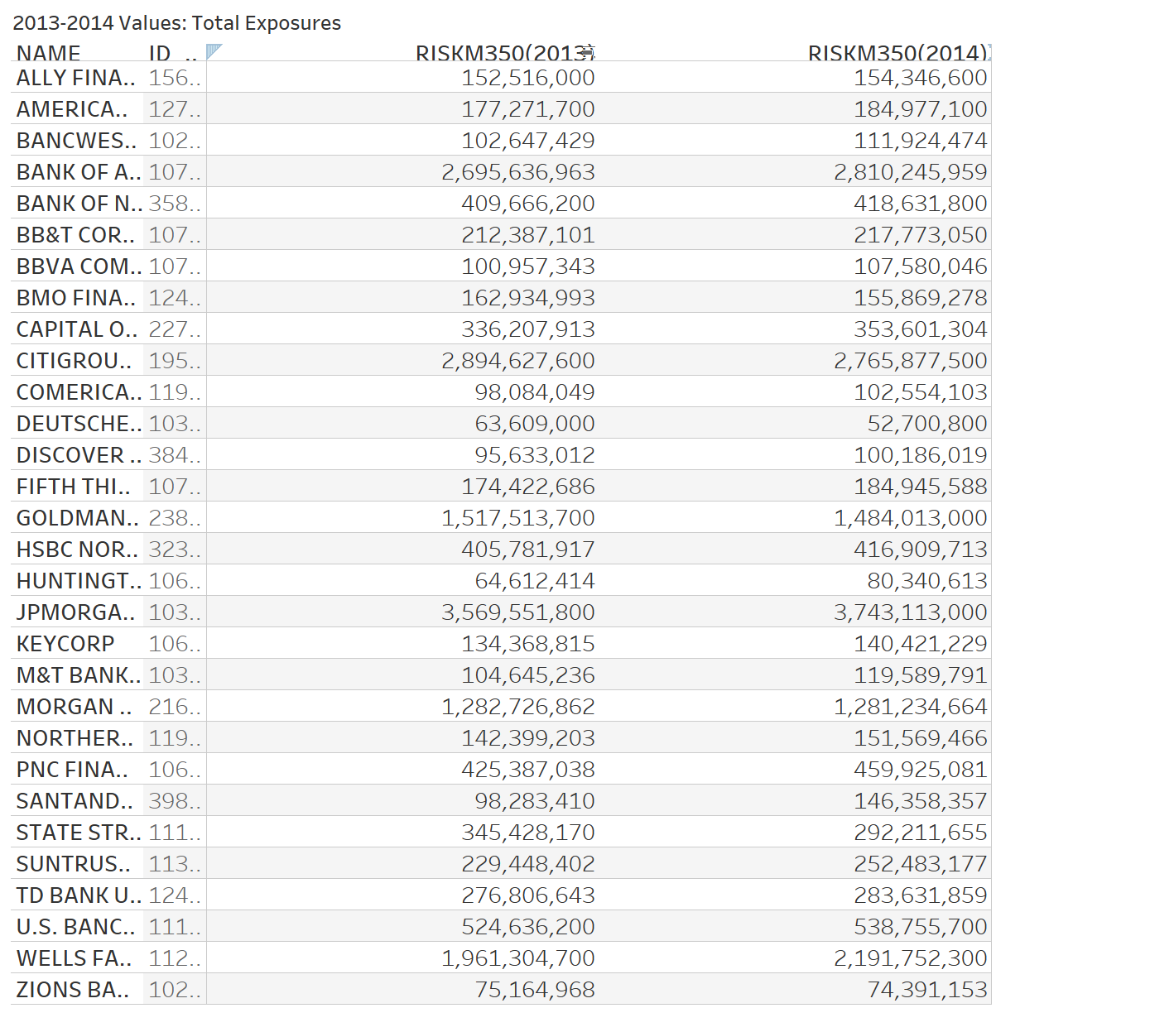

Slide 43
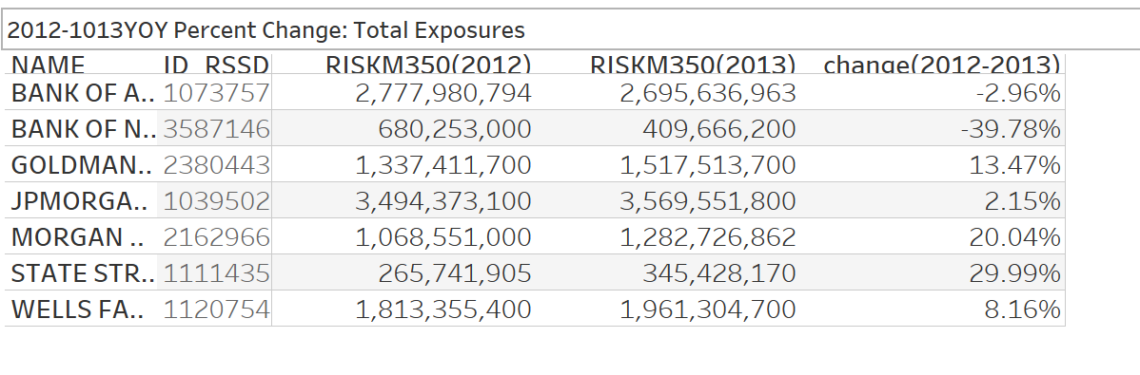

Slide 44
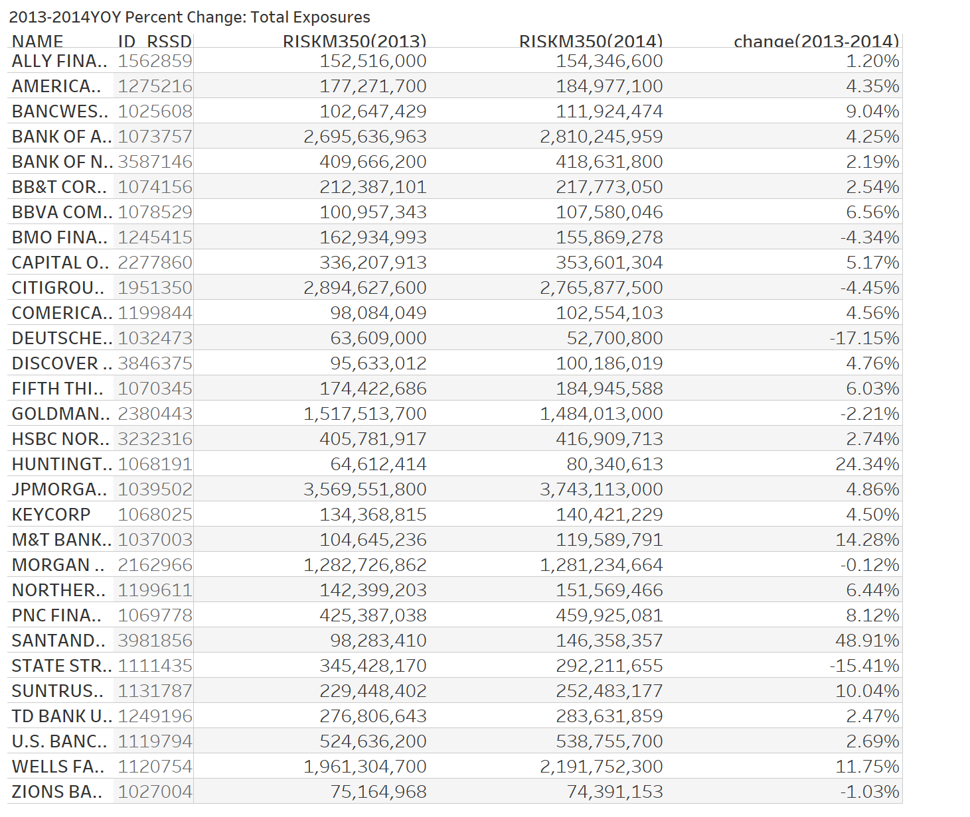

Slide 45
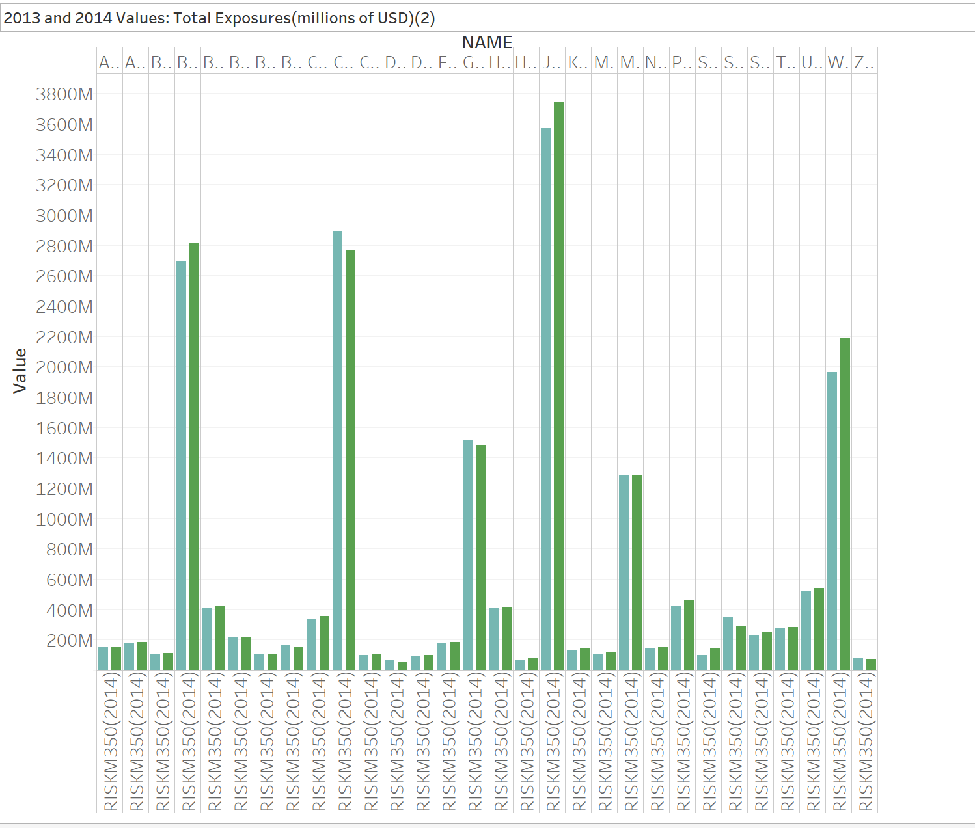

Slide 46
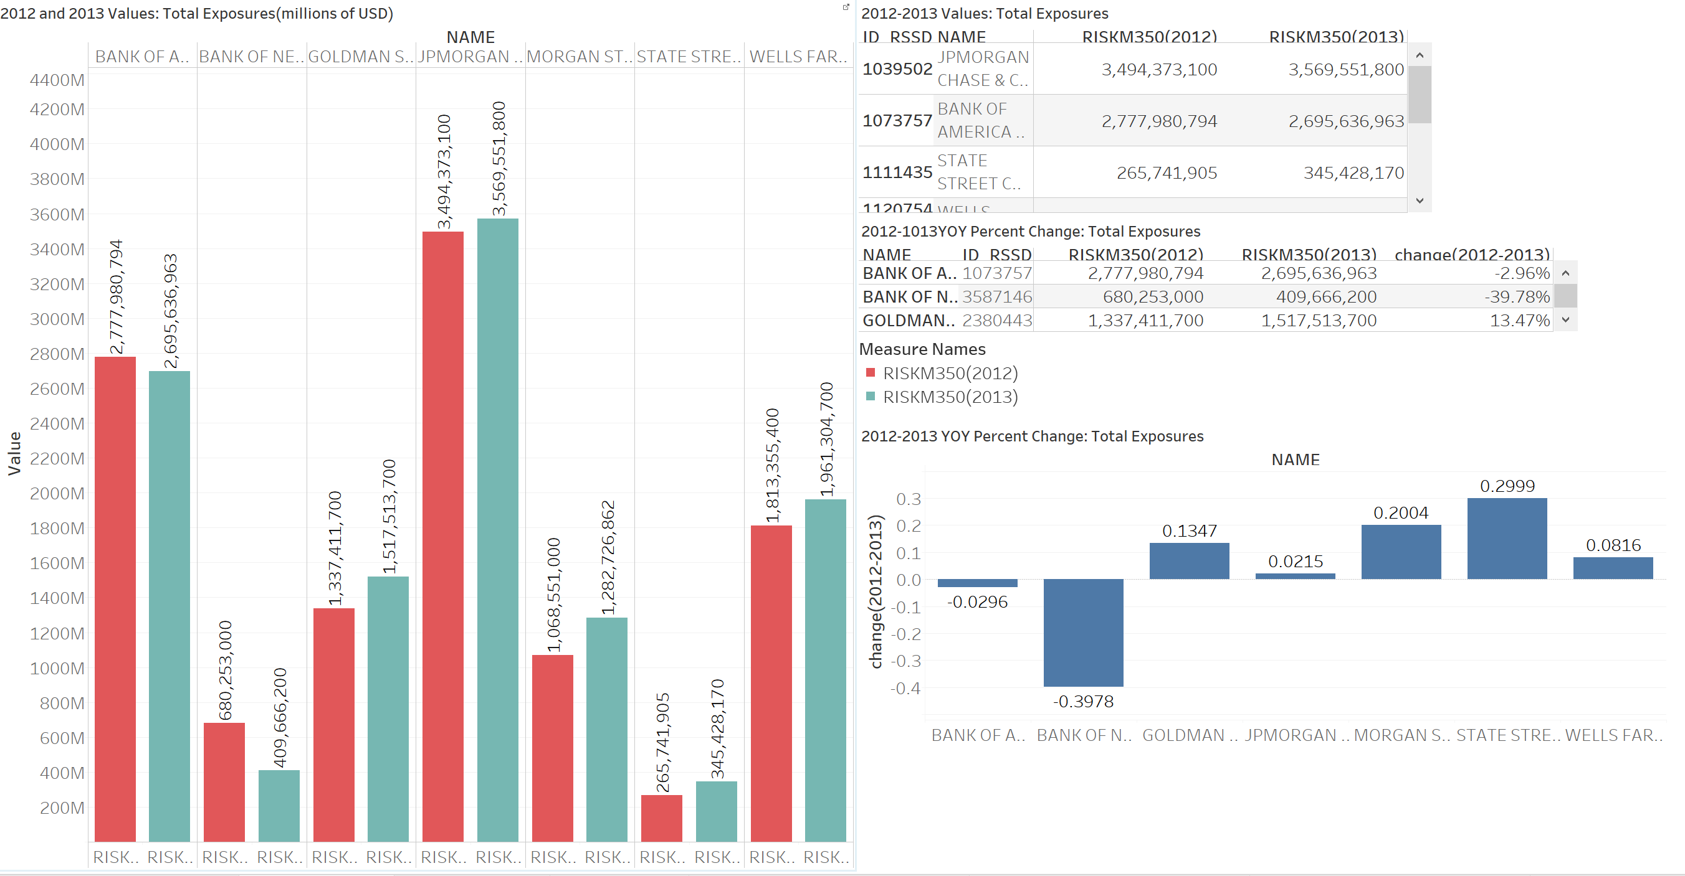

Slide 47
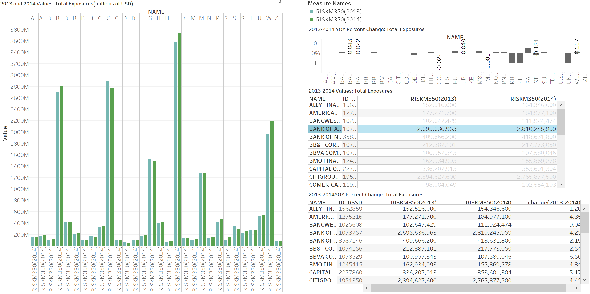

Slide 48
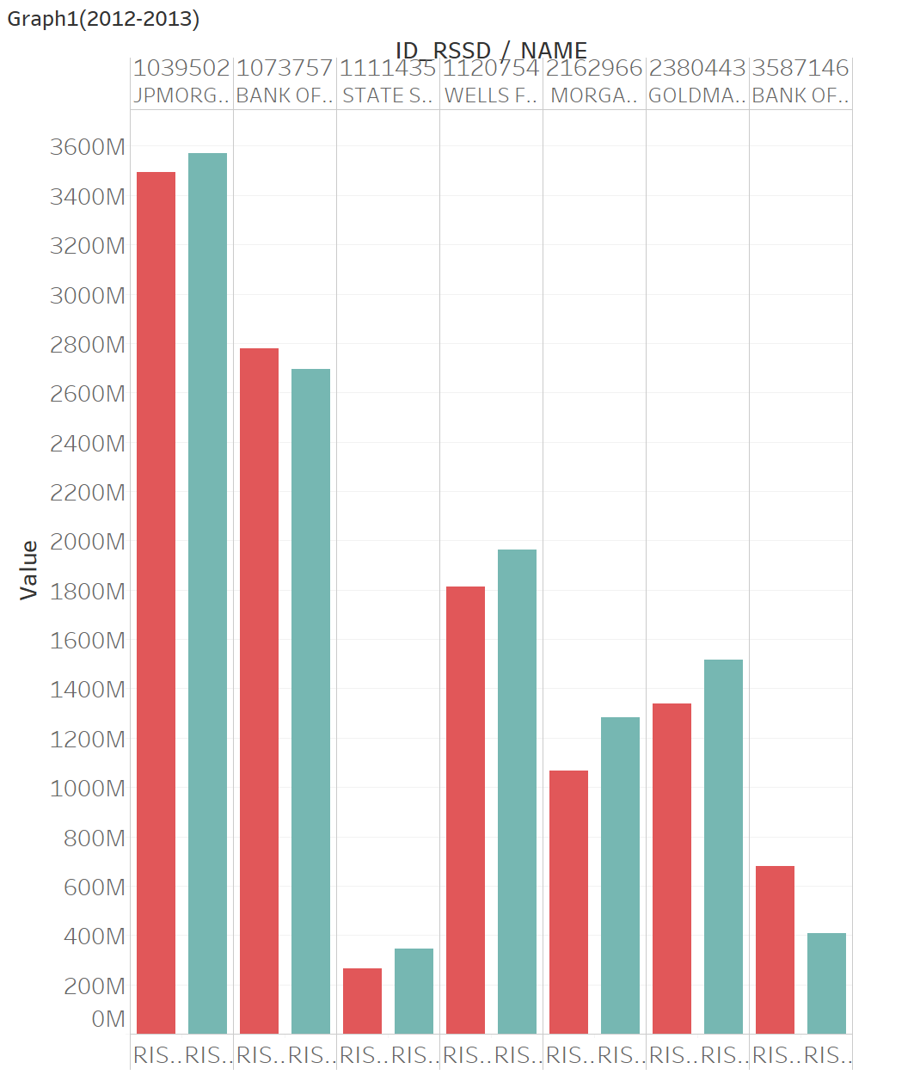
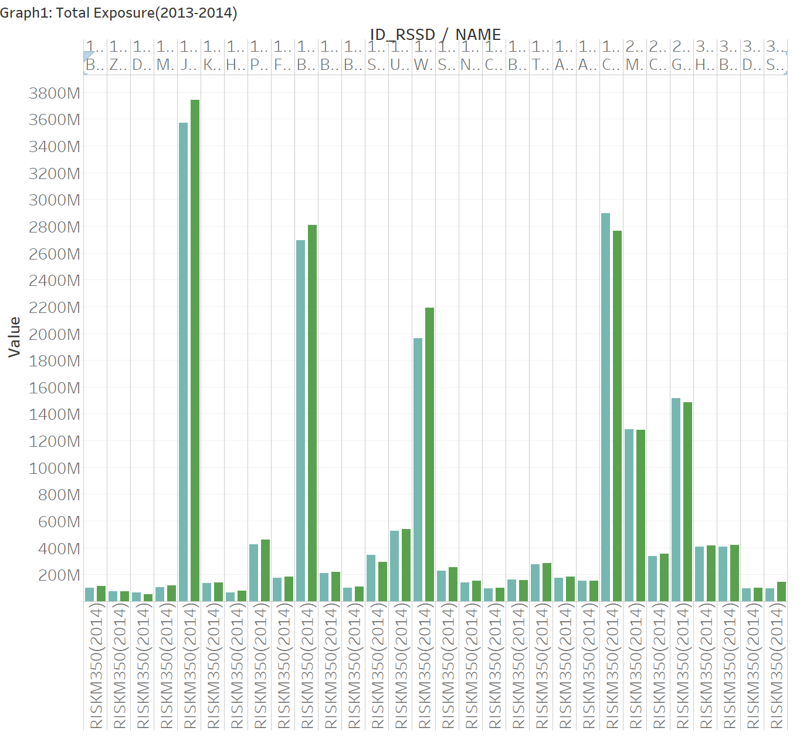

Slide 49
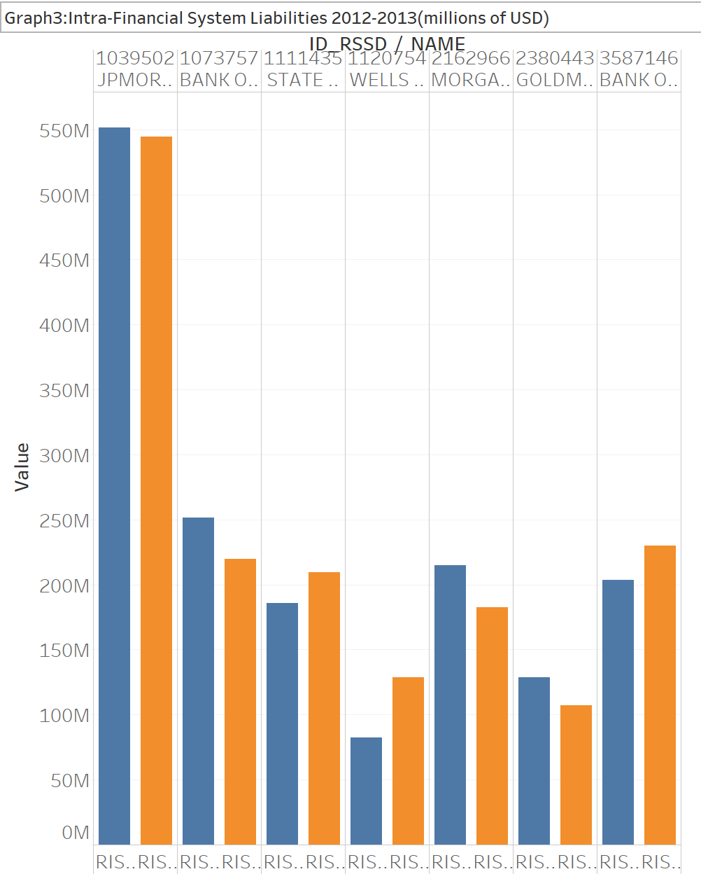
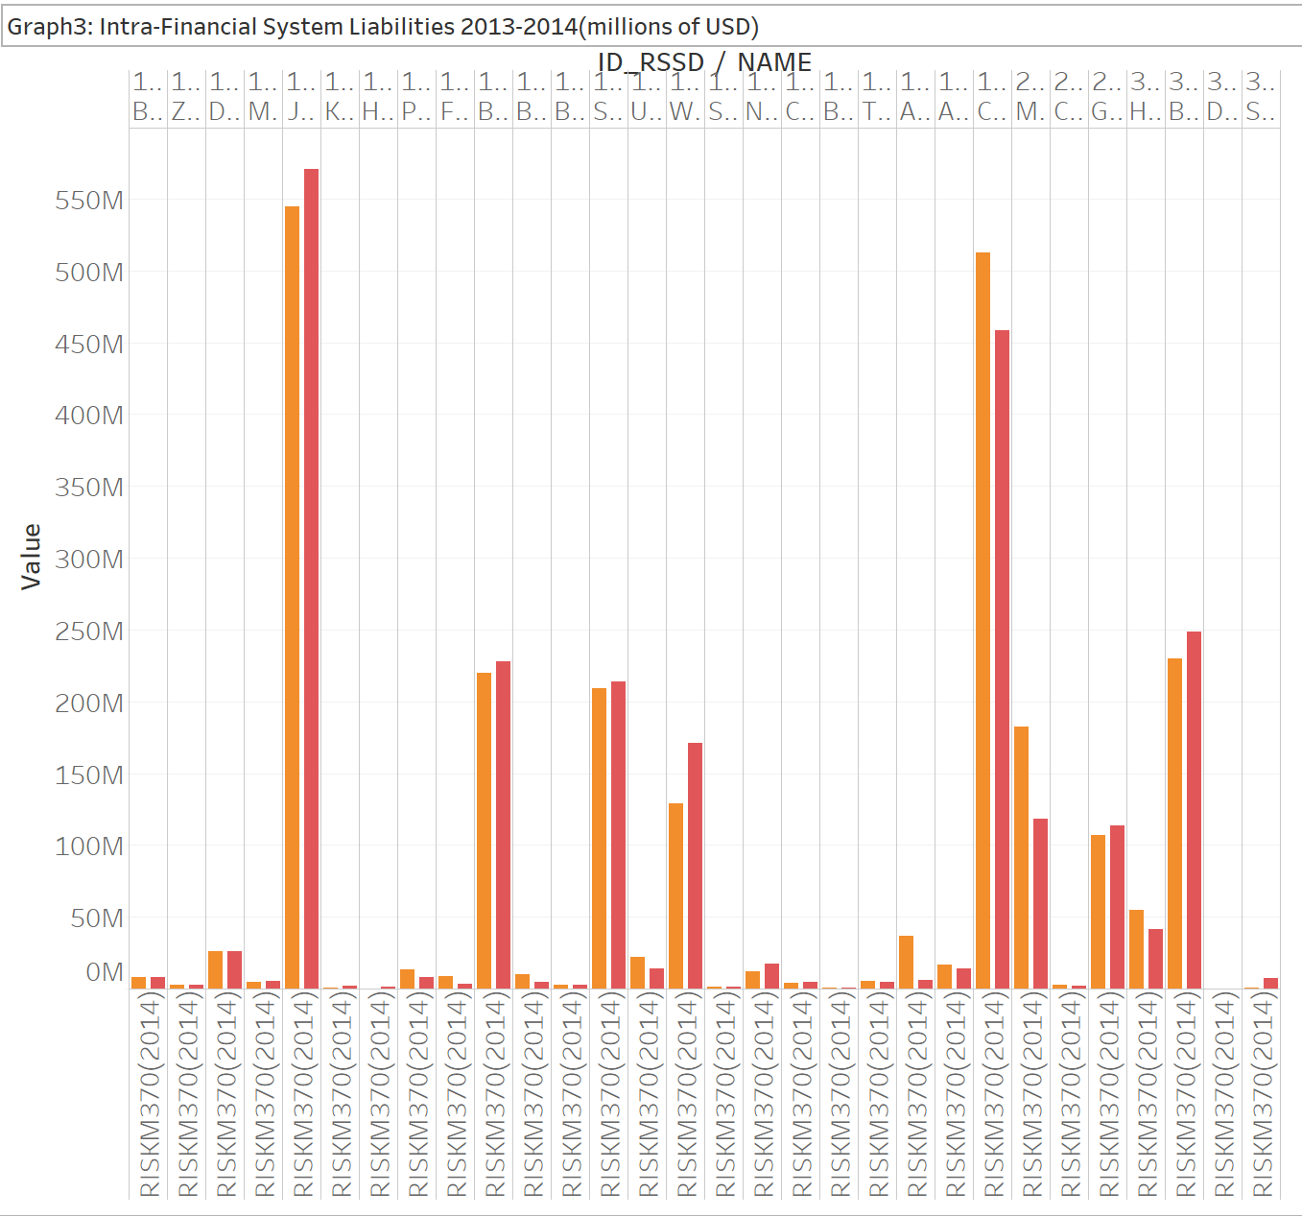

Slide 50
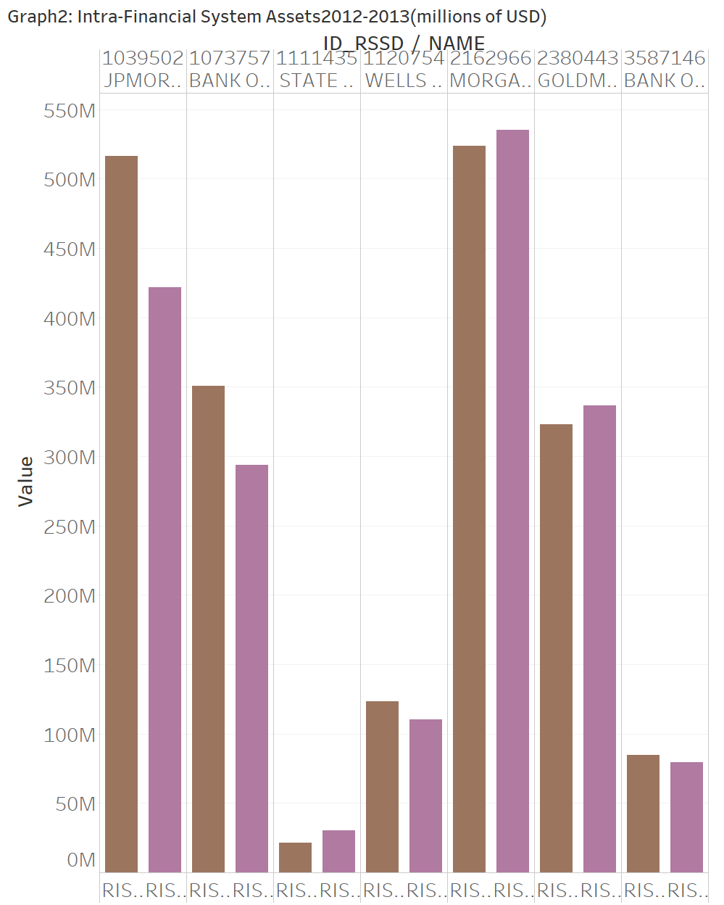
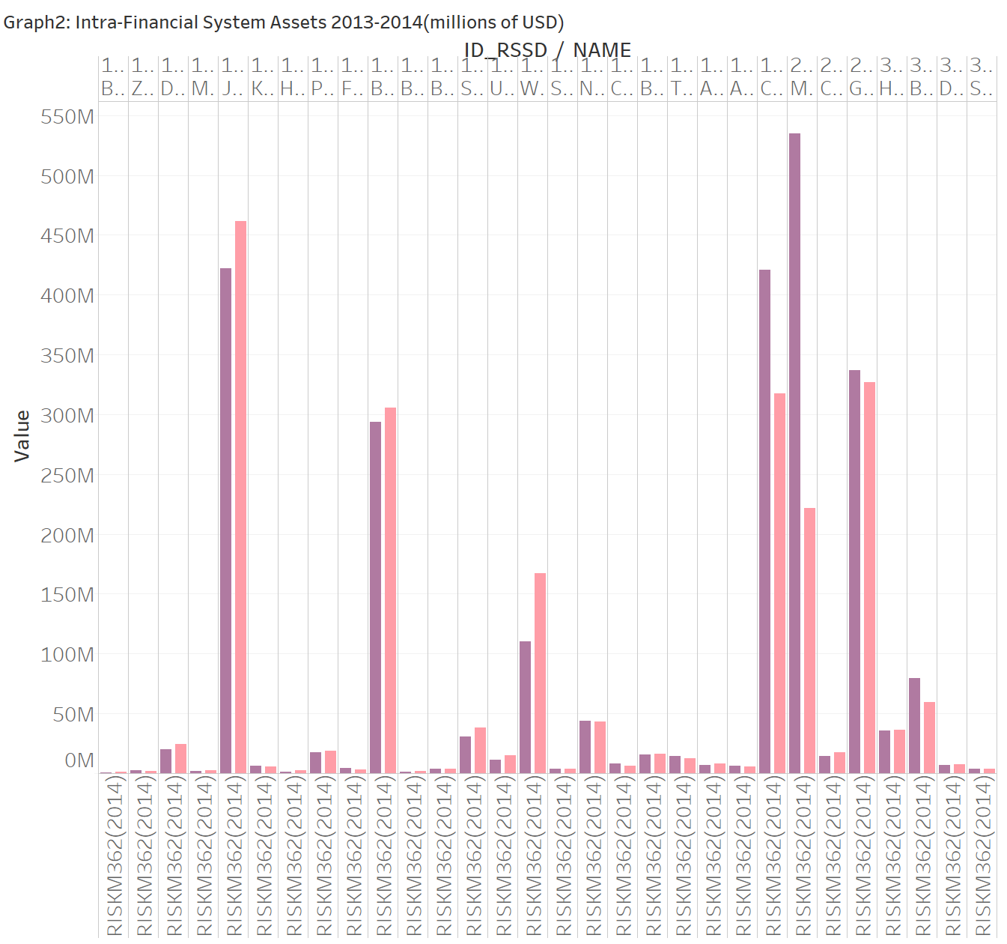

Slide 51
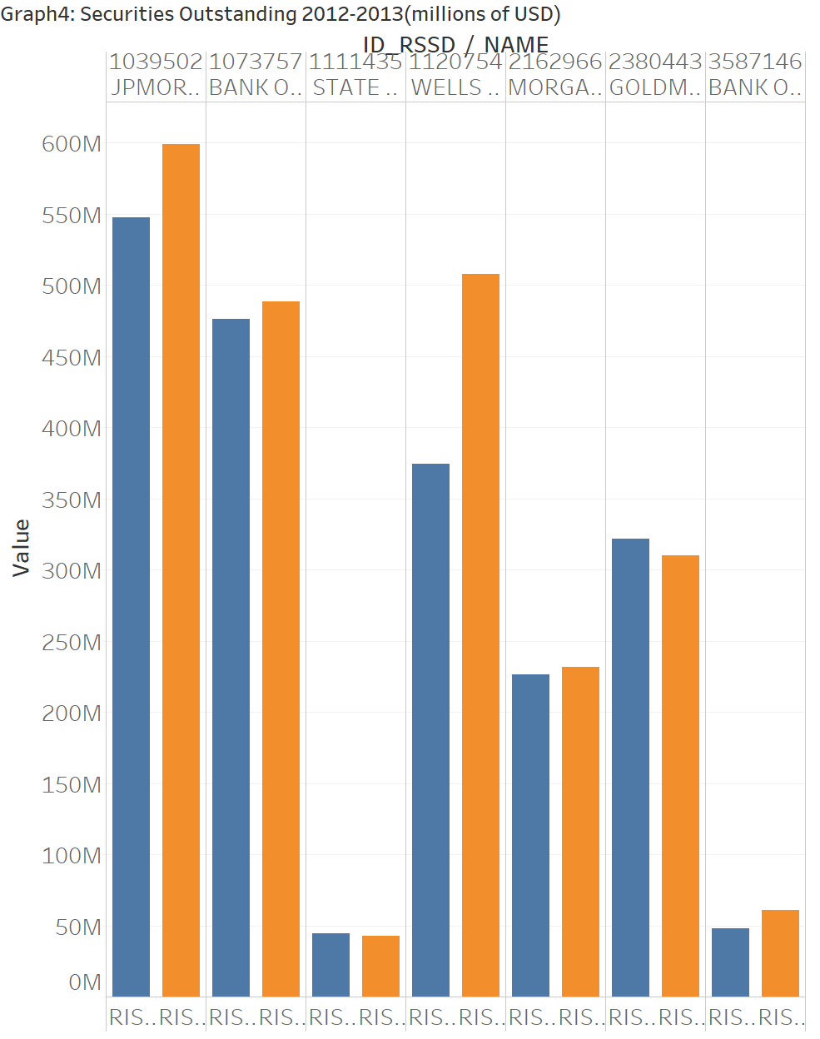
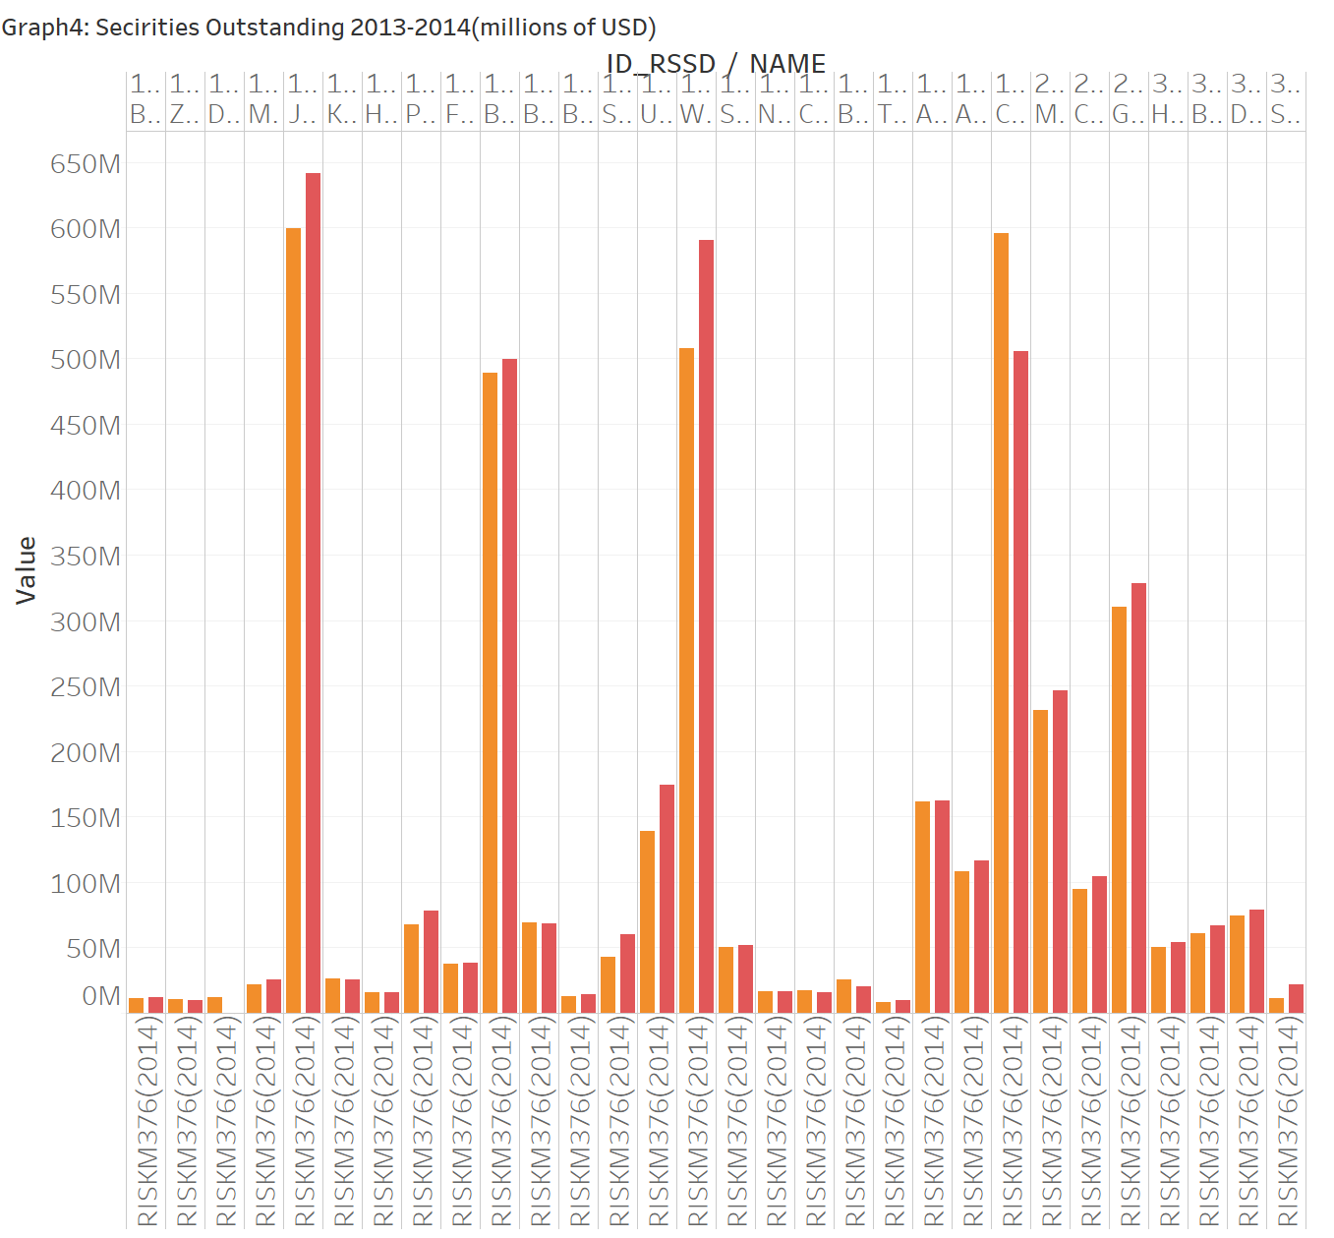

Slide 52
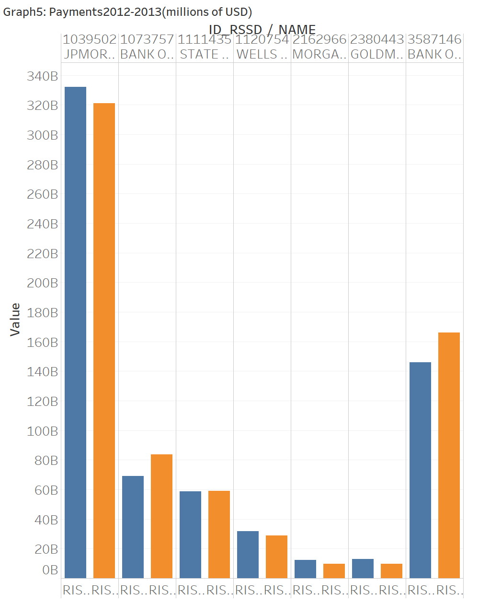
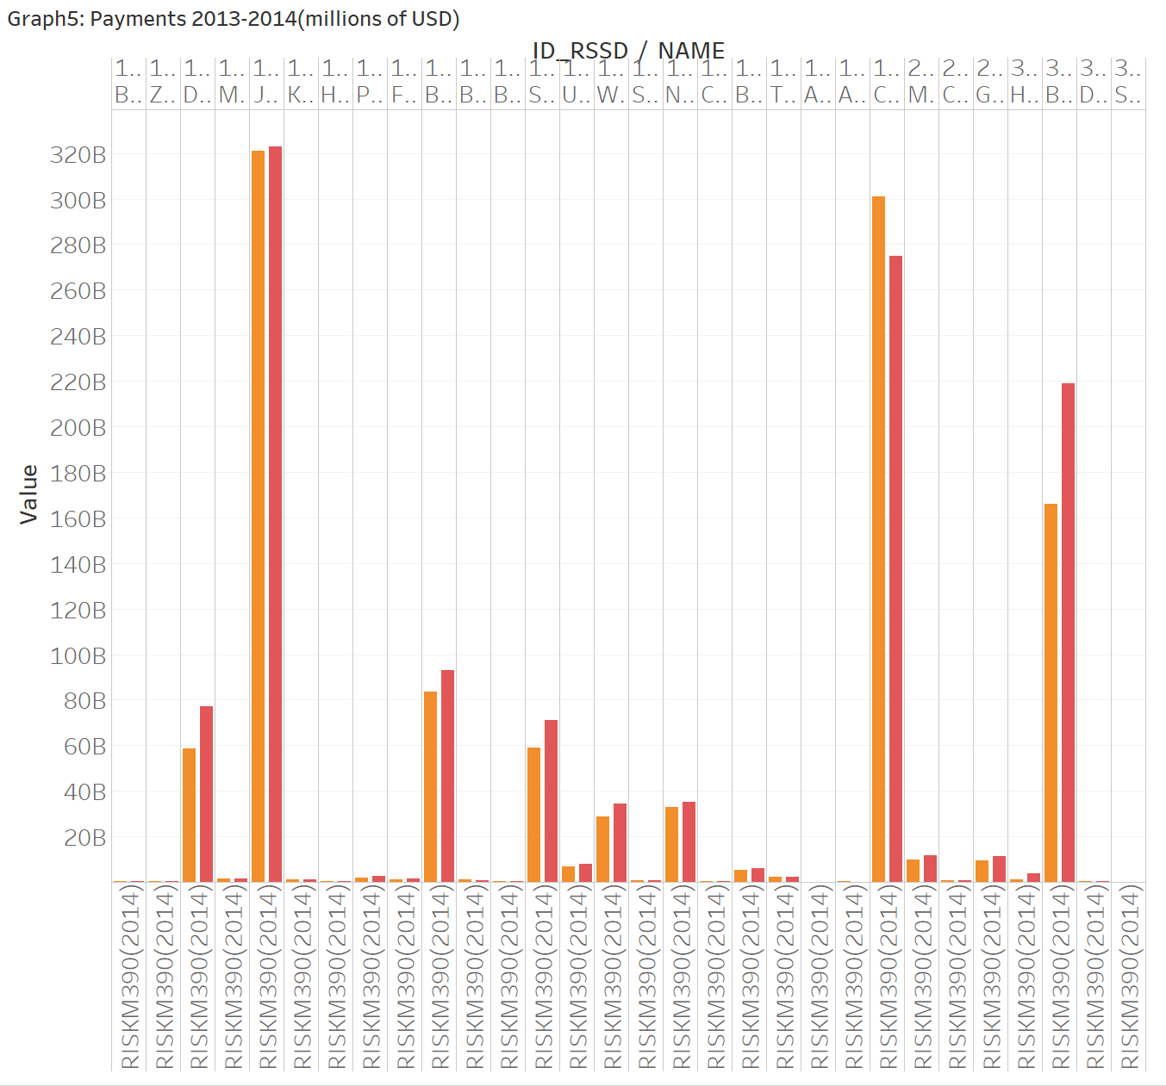

Slide 53
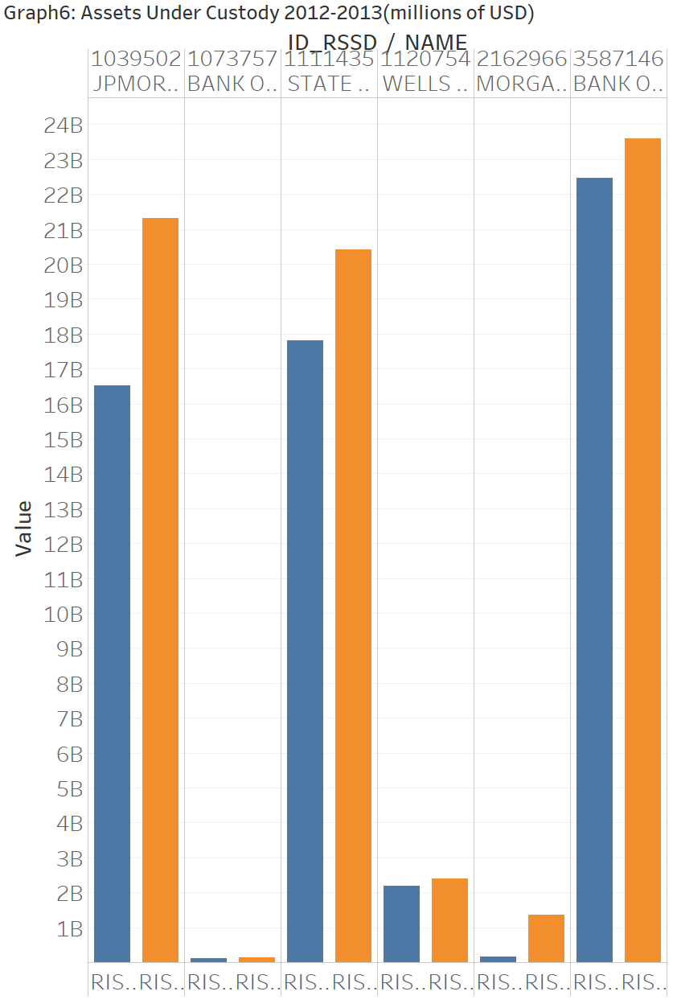
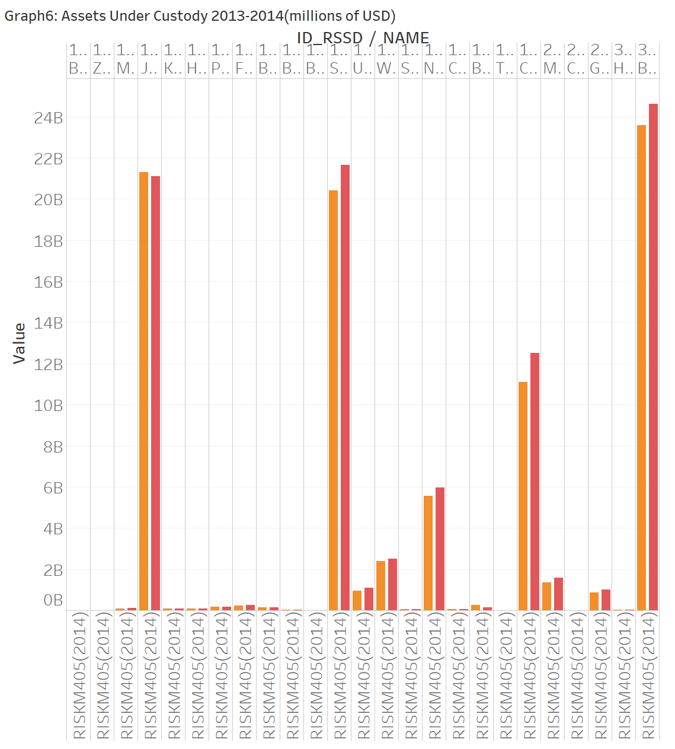

Slide 54
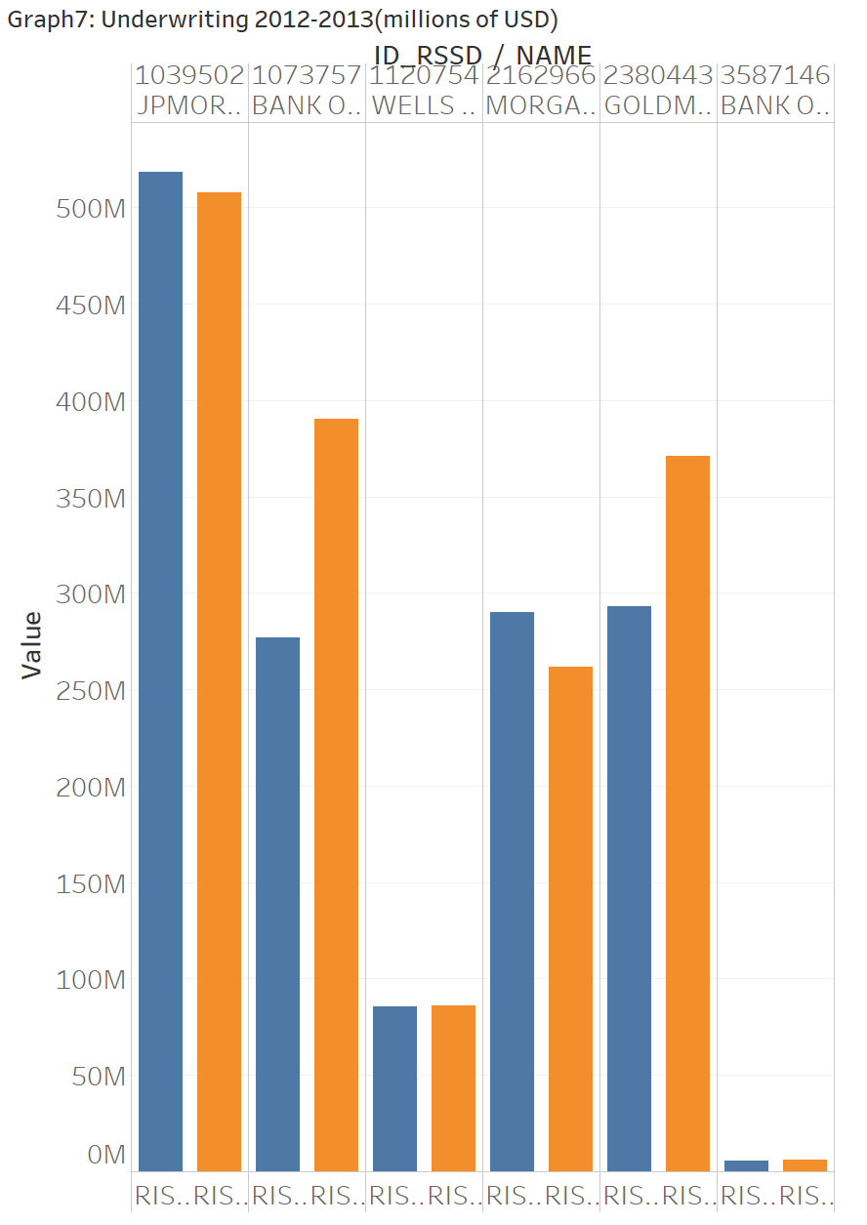
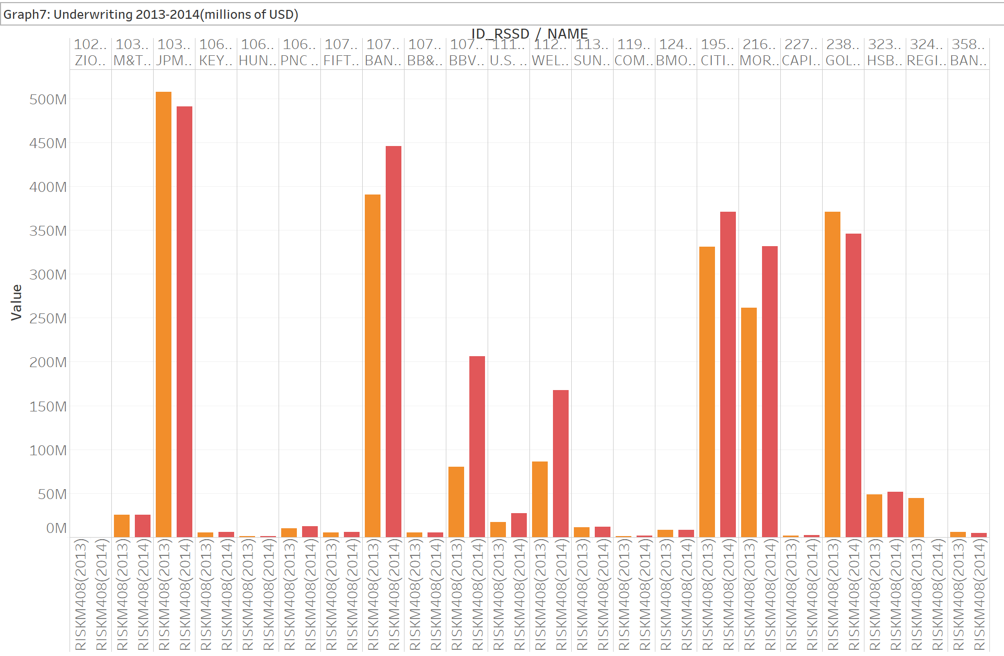

Slide 55
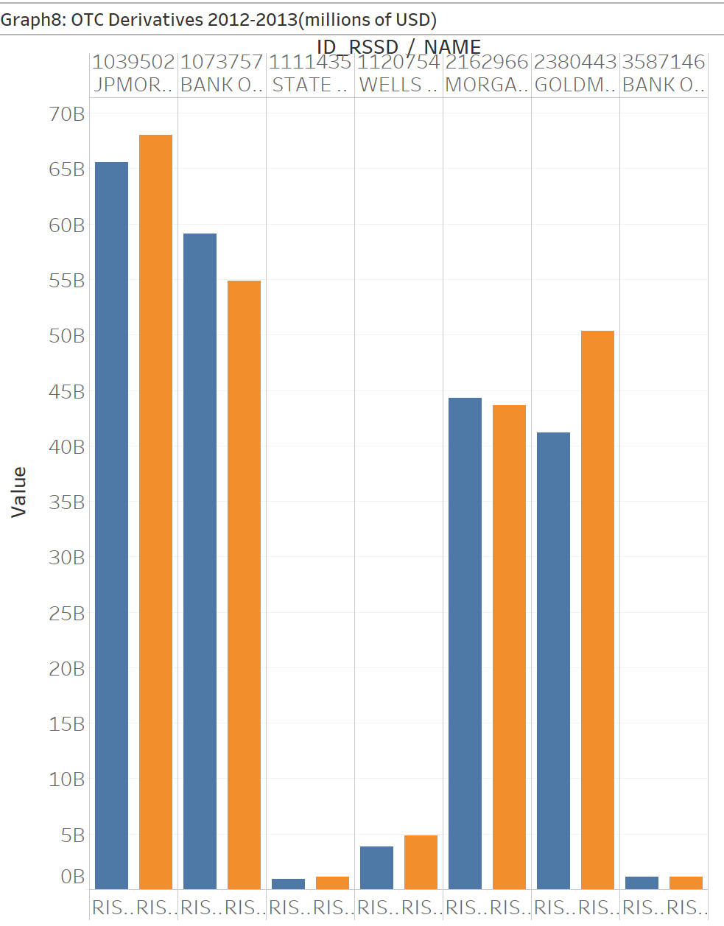


Slide 56


Slide 57



Slide 58



Slide 59



Slide 60

Part3.2
Other charts we can use to replace bar chart.

Slide 61

Part3.3 -Year to Year Comparison(Dashboard Graph3)
Put all three years data into Tableau.
Include 2012-2013-2014 value.
2012-2013 Year to Year Present Change
2013-2014 Year to Year Present Change

Slide 62


Slide 63



Slide 64


Slide 65


Slide 66


Slide 67


Slide 68


Slide 69


Slide 70


Slide 71


Slide 72


Slide 73


Slide 74


Slide 75


Slide 76



